Slide 1
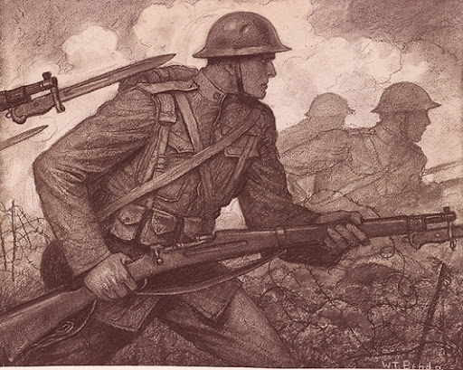
The first year of world war 1
By Ronan Quigley

Slide 2
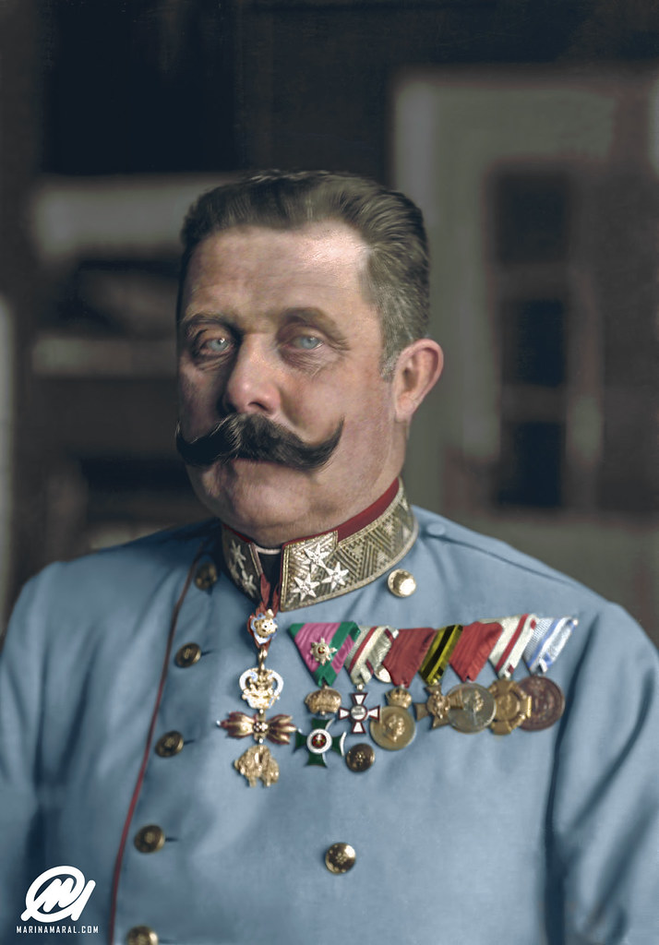
How ww1 started
World war 1 took place in 1914 started by a chain of events starting with a member of a Serbian terrorist group called “The Black Hand” named Garvillo Princip
assassinating Archduke Franz Ferdinand, who was the emporer of Austria's nephew.
Archduke Franz Ferdinand of Austria
------→
However,there are other reasons for
ww1 starting…

Slide 3
Before WW1 was triggered, a number of defence alliances existed between the major European countries.This means that if one country got in a war,other countries would have to help them.
Britain, France, Ireland and Russia were part of an alliance called the Triple Entente, while Germany aligned itself with Austria-Hungary – known as the Central Powers.
After the assassination of Archduke Franz, Austria-Hungary threatened war on Serbia. They set out some very harsh demands that Serbia must meet. Germany sided by Austria-Hungary, while Russia sided with the Serbians. At this point, Europe was at the brink of going to war.

Slide 4
The first battle of ww1
The first battle of ww1 was called the first Battle of the Marne.here are some fact that relate.
The First Battle of the Marne was fought between Germany and the allies of France and Britain.
World War I had begun only about one month before the battle. During that time, Germany had been steadily gaining ground and winning the majority of the battles. They had advanced through Belgium and were marching through France.
It was French General Joseph Joffre who decided that it was time for the Allies to counterattack the Germans. At first, British leader Sir John French said his men were too tired from the retreat to attack. However, British war minister, Lord Kitchener, convinced him to join with General Joffre in the attack.
after a few days of fighting, the Germans were forced to retreat. They retreated back to Aisne River in northern France. Here they built long lines of trenches and managed to hold off the Allied army. They would hold this position for the next FOUR YEARS!

Slide 5
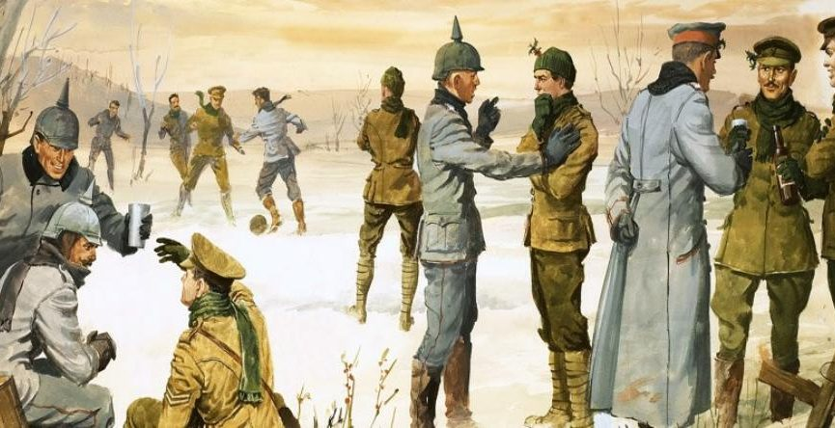
The one good day of ww1
The only peaceful day of ww1 was the Christmas truce.
On Christmas morning,the British started singing Christmas carols then the Germans did the same,then,one thing led to another,and they all started playing football!
But the sad thing is that they only got a few minutes of peace and then the very next day,back to fighting.

Slide 6
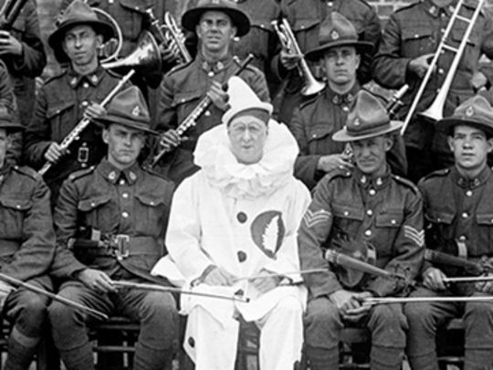
I hope you enjoyed my project! The end!

