Slide 1
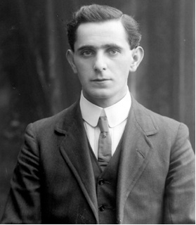
1916
The Leitrim Connection
Brian Mc Bride

Slide 2
1916 – The Leitrim Connection
I am doing my project on Sean Mac Diarmada, a Leitrim man and one of the great leaders of the 1916 Easter Rising.
The reason I am basing my project on Mac Diarmada is because my dad grew up in a little village not far from where Sean grew up.
Also my grandad had to clear out Mac Diarmada’s house around 30 years ago and he kept an old cooking pot in his memory.

Slide 3
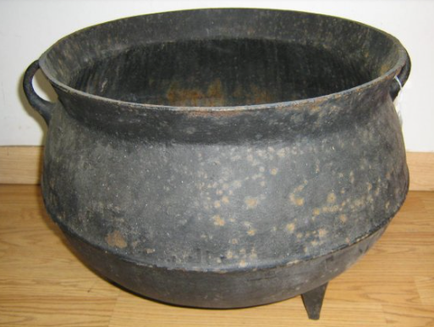
1916 – The Leitrim Connection
The cooking pot from my Grandad’s garden
that Sean MacDiarmada would have
cooked his potatoes in.

Slide 4
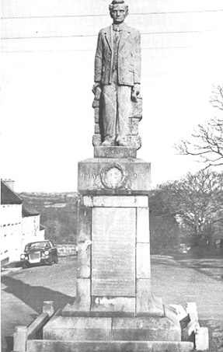
His Early Years
Sean Mac Diarmada was born in 1883 in a small thatched cottage near Kiltyclogher, a small village in Leitrim, near the Fermanagh border.
MacDiarmada Statue
Kiltyclogher

Slide 5
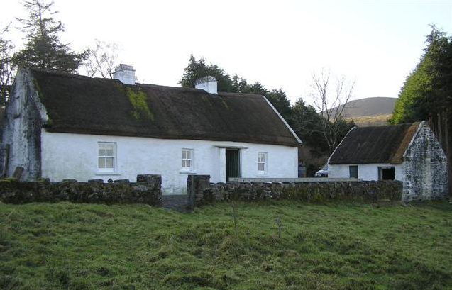
His Early Years
There was a lot of poverty around the village he grew up in. He had two brothers and five sisters and his life was very hard. He went to a Christian Brothers School.
MacDiarmada’s Birthplace

Slide 6
His Life Before The Rising
Mac Diarmada’s first job was a gardener in Scotland.
He then worked as a conductor on the trams in Belfast.
It was around this time he because interested in Irish Freedom.
He joined the Irish Republican Brotherhood, Sinn Fein, the Ancient Order of the Hibernians and the Gaelic League.
In 1908 MacDiarmada went to live in Dublin and became close friends with Tom Clarke.

Slide 7
His Life Before The Rising
In 1910 he became the manager of the newspaper called ‘Irish Freedom’.
Around this time he also got polio and was very sick.
From then on, he had to use a walking stick to help him walk.
In 1913 he became a member of the Irish Volunteers.
In 1915 he joined a secret part of the IRB which planned the Easter Rising.

Slide 8
His Part In The Easter Rising
As members of the IRB, Sean MacDiarmada & Tom Clarke were the people most responsible for planning the rising.
But because of his polio MacDiarmada did not really take part in the fighting. He stayed in the GPO in Dublin as one of the members of the Government that the Easter Rising Leaders declared.
He was one of seven people who signed the 1916 proclamation.

Slide 9
His Execution
After a court-martial on the 9th May 1916, for his part in the rising, Mac Diarmada was executed by firing squad on the 12th May in Kilmainham Gaol at the age of 33.
Before his execution, in his final letters MacDiarmada wrote that he felt happiness like he never felt before that he was going to die that the Irish Nation might live.
He also wrote that he saw his execution as part of another days work, which shows how brave he was.

