Slide 1
1916
Easter
rising

Slide 2
General 1916 facts
Roald Dahl was born in 1916.
The first ever radio was made in 1916
In 1916 one of the British people that surrendered to Padraig Pearce went to Hollywood

Slide 3
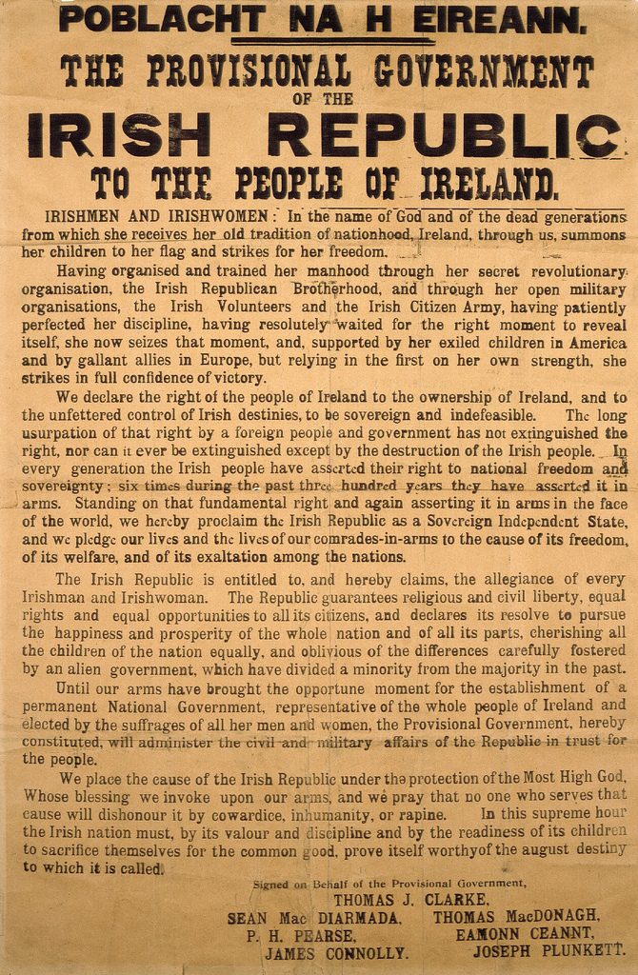
Proclamation
Padraig Pearce read the proclamation outside the GPO, Sackville street. The proclamation was signed by …
Padraig Pearce
James Connolly
Joseph Plunket
Sean McDiarmada
Tom Clarke
Thomas McDonagh
Eamonn Ceant

Slide 4
Leaders Who Signed The PROCLAMATION

Slide 5
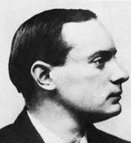
Padraig Pearce
Born: November 10, 1879, Dublin
Died: May 3, 1916, Dublin
Nationality: Irish
Parents: Margaret Pearce
Siblings: Willie Pearce, Margaret Mary Pearce
Padraig Pearce is an Irish teacher,
Poet and writer. He was in the
Gaeilge revival.
PADRAIG PEARCE

Slide 6
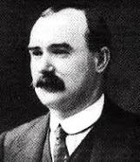
JAMES CONNOLLY
Born: June 5, 1868, Cow gate, Edinburgh, UK
Died: May 12, 1916, Kilmainham Gaol, Dublin
Nationality: British
Wife: Lillie Connolly
Children: Nora Connolly Ò Brien, Roddy Connolly
He was famous for leading workers.
He said if we don’t get a raise he will go
On a strike.
James connolly

Slide 7
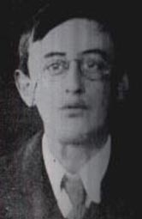
Joseph Mary Plunket
Born: November 21, 1887, Dublin
Died: May 4, 1916, Dublin
His brother and dad`s names were both George
He was co-editor on the Irish Review and director of the Irish Theatre. He joined the volunteers in 1913. He was responsible for military strategies during the war with the aid of Michael Collins.
JOSEPH Mary Plunket

Slide 8
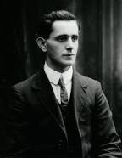
Sean mcdiarmada
Born: January 27, 1883 Kiltycloger
Died: May 12, 1916 Dublin
Sean McDiarmada was a politician then became a member of the IRB and joined the Volunteers. He was included in the Gaeilge revival and he inspired people. He was a close friend of Tom Clarke.
Sean McDiarmada

Slide 9
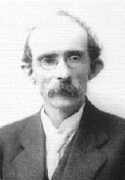
Tom Clarke
Born: March 11, 1858, UK
Died: May 3, 1916 Dublin
The proclamation was first signed by Tom Clarke as he was the oldest leader and most respected.
Tom Clarke

Slide 10
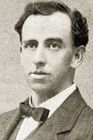
Thomas Mcdonagh
Born: February 1, 1878, Cloughjordan
Died: May, 1916, Dublin
He was a poet and teacher. He taught at St. Enda`s. He joined the volunteers in 1914. His play When the dawn is come was produced at the Abbey theatre.
Thomas Mcdonagh

Slide 11
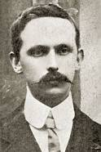
Eamonn Ceant
Born: September 21,1881, Ballymoe
Died: May 8, 1916 Dublin
He was one of the people who founded the Irish Volunteers. In 1900 he joined the Gaelic league.
EAMONN CEANT

Slide 12
By: Saket Cilaveni

