Slide 1
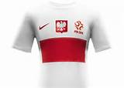
REPREZENTACJA POLSKI W PILCE NOZNEJ POLAND NATIONAL FOOTBALL TEAM By Aaron Perry

Slide 2
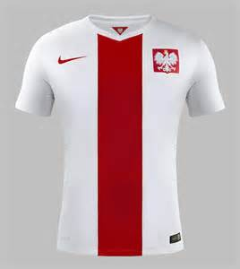
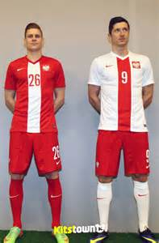
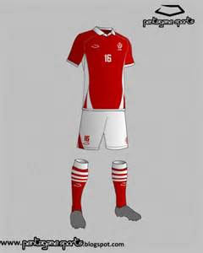
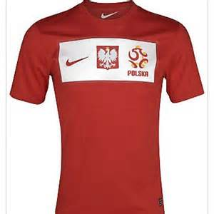
TEAM COLOURS
POLANDS TEAM COLOURS ARE A COMBINATION RED AND WHITE
It always has the famous white eagle badge on the front and hasn’t changed much since 1921

Slide 3
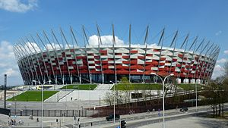
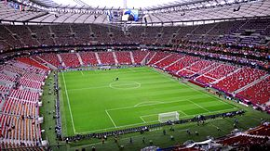
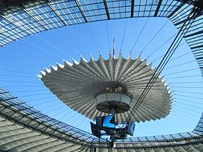
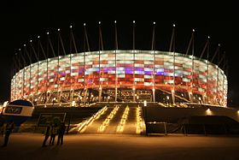
NATIONAL STADIUM WARSAW
POLAND PLAY THEIR HOME GAMES IN THE STADION NARODOWY IN WARSAW, THE CAPITAL OF POLAND
IT CAN HOLD 58,145 PEOPLE SEATED, WITH A RETRACTABLE ROOF AND UNDER SOIL HEATING IT’S THE BIGGEST IN POLAND

Slide 4
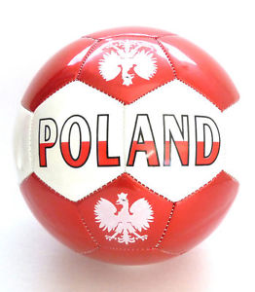
UEFA Euro 2016 qualification
Poland were drawn in Group D along with Germany, Gibraltar, Georgia, Scotland, and the Republic of Ireland.
On 7 September 2014,
Poland beat
Gibraltar 7–0 to earn their first points .
Poland on 11 October 2014 beat reigning world champions Germany for the first ever time in Warsaw.
On 29 March 2015, Poland earned a 1–1 draw away in Ireland to remain top of the group.
A first half strike from Peszko gave the Poles the lead before an injury time equalizer from Shane Long rescued a late point for Ireland
On 11 October 2015, Poland secured a place in UEFA Euro 2016 when they beat Ireland 2–1 in Warsaw.
Poland finished second in the group behind Germany ,Ireland finished third and had to qualify through the play offs.
Robert Lewandowski ended the qualifying campaign with 13 goals, thus tying with Northern Ireland's David Healy for the most number of goals scored in a single European Championship qualifying campaign.
P W D L GD PTS
Germany
10 7 1 2 +15 22
10 6 3 1 +23 21
10 5 3 2 +12 18
Poland
Republic of Ireland

Slide 5
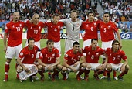
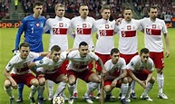
POLAND EURO
2016
POLAND HAVE BEEN DRAWN IN GROUP C ALONG WITH GERMANY, UKRAINE AND NORTHERN IRELAND .
ON THE 12TH OF JUNE POLAND PLAYED THEIR 1ST MATCH IN NICE AGAINST THE NORTH, THEY WON 1-0 WITH A GOAL FROM MILIK IN THE 51ST MINUTE TO GIVE THEM A GREAT START TO THE FINALS WITH Grzegorz Krychowiak GETTING MAN OF THE MATCH
NEXT UP IS GERMANY ON JUNE 16TH IN THE STADE DE FRANCE IN PARIS
FOLLOWED BY THE UKRAINE MATCH IN STADE VELODROME,MARSEILLE ON THE 21ST OF JUNE.
A POINT FROM EITHER MATCH SHOULD BE ENOUGH TO GET TO THE NEXT ROUND.

Slide 6
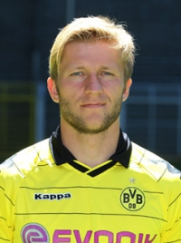
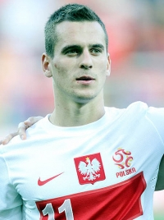
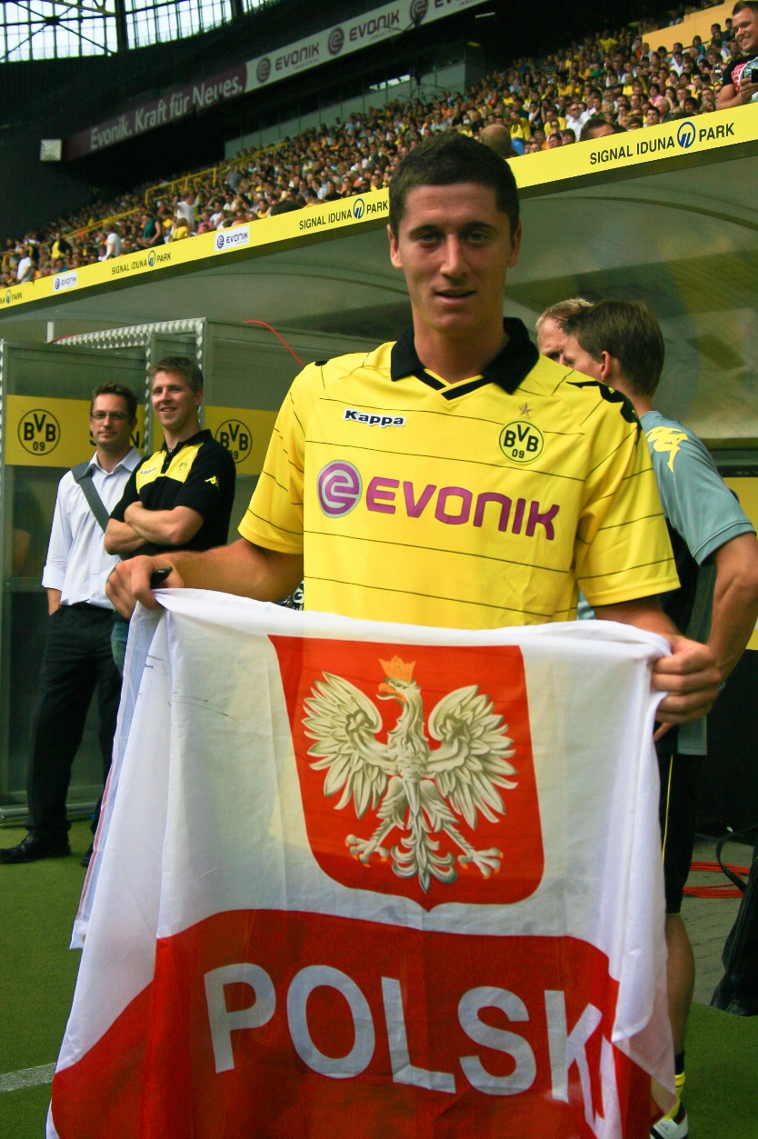
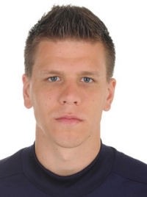
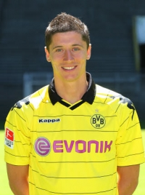
NAME ARKADIUSU MILIK
AGE 22
CLUB AJAX
POSITION FORWARD
27 CAPS AND 11 GOALS
NAME
AGE 27
CLUB
POSITION
OVER 61 CAPS AND 18 GOALS
Robert Lewandowski
PLAYERS TO LOOK OUT FOR
Bayern Munich
forward
ARSENAL GOALKEEPER
Jakub Błaszczykowski
POLISH FOOTBALLER OF
THE YEAR 2008 AND 2010
Wojciech Szczęsny

Slide 7
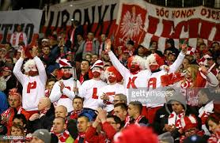
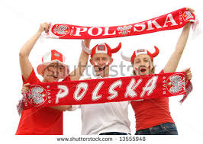
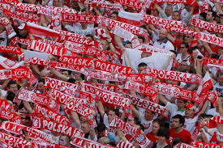
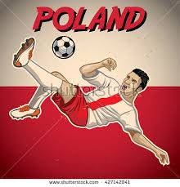
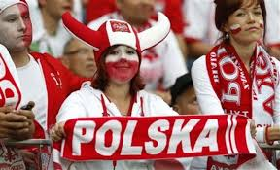
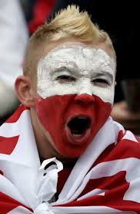
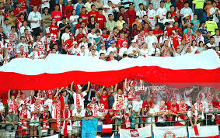
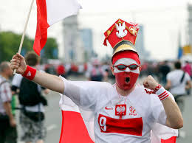
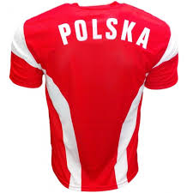
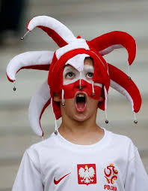
FAN ZONE

