Slide 1
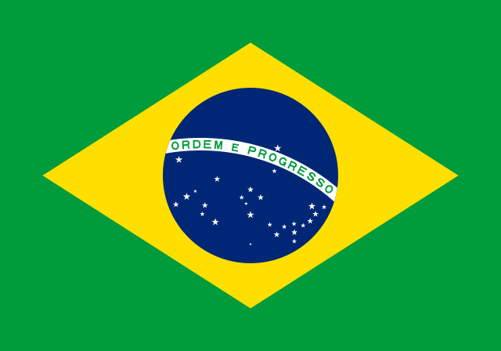
Brazil Project
By Fionn Vennard

Slide 2
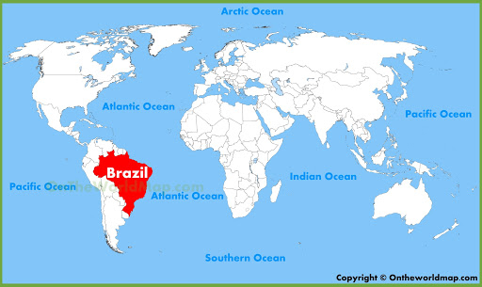
Brazil location Brazil is located in South America

Slide 3
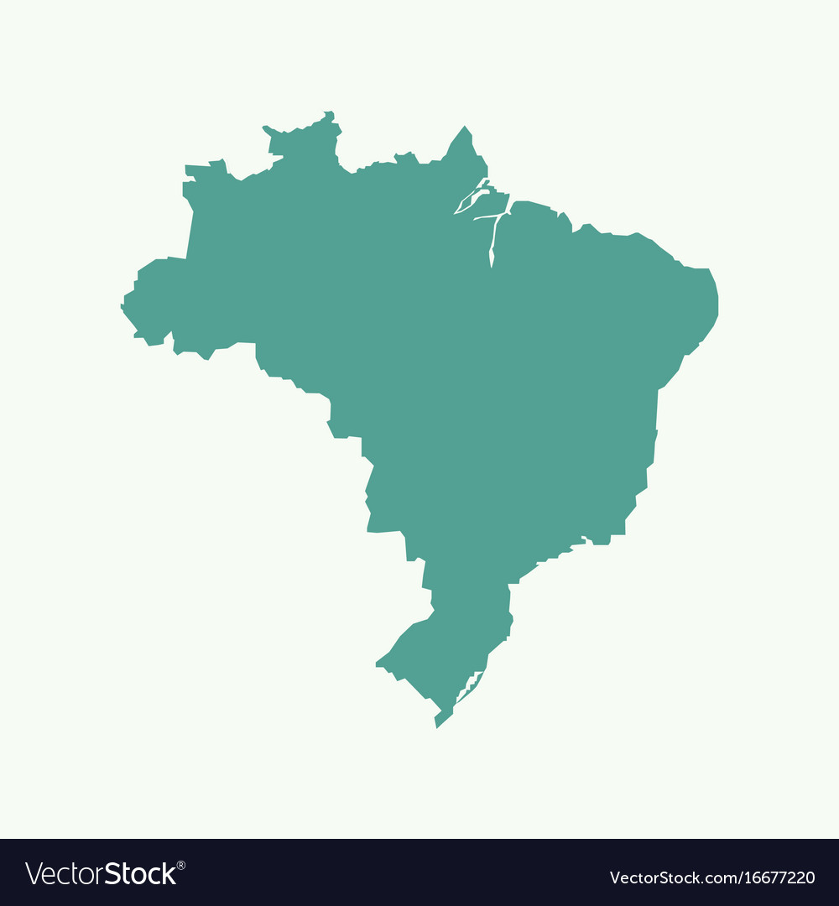
Brazil

Slide 4
Size
Brazil is 8.516 million square kilometres in area.

Slide 5
The History of Brazil
Brazil was founded on the 7th of September 1822. From then on countries were fighting to claim Brazil and the rest of South America.
Portugal claimed Brazil.

Slide 6
The Geography of Brazil
Brazil is divided up into five parts : The Guiana Highlands in the North, The Amazon lowlands, The Pantanal in the Central-west, The Brazilian Highlands and the coastal lowlands.

Slide 7
Currency
Brazil’s currency is the Brazilian real.
One Brazilian real in Brazil is worth 0.16 cent in Ireland.

Slide 8
Landmarks
Five must see landmarks in Brazil are:
The Iguazu Falls,
The Netoiri Contemporary Art Museum,
The Christ Redeemer,
The Sugarloaf Mountain and
The Bonito.

Slide 9
Language
The Brazilian people speak Portuguese.
They speak Portuguese because they were colonised by Portugal in April 1500.

Slide 10
Traditions
Capoeira is a traditional Brazilian martial art.
Brazil is famous for the festivities of “Carnaval”.

Slide 11
Population
Brazil’s population is estimated at 212,559,417 people.
Brazil’s population is equivalent to 2.73% of the total world population.

Slide 12
Brazilian food
The Brazilian people eat Brazilian cheese bread, Brazilian style beans, black bean and pork stew, Brazilian style rice, and tropeiro beans.
The Brazilian people drink fruit smoothie, coconut water, sugar juice, tea, and Brazilian beers.

Slide 13
Brazilian Sports
Popular sports in Brazil are football, volleyball, MMA, basketball, tennis, and motor sports.
The most popular sport in Brazil is football.

Slide 14
Animals in Brazil
Five main animals in Brazil are : Toco Toucan, Three toed sloth, Piranha, Anteater and Capybara.
The main animal in Brazil is the Toco Toucan.

