Slide 1
The Famine Project
By Gowtham Dasari

Slide 2
Introduction
The Great Irish famine began in 1845 and ended in 1849 this catastrophe started when a disease called blight affected the potato crop, this was a major problem because when Ireland was controlled by Britain it was considered the poorest of the poor so where I’m going with this is basically Ireland was very poor and the potato crop was the main food for the poor.

Slide 3
General facts
The famine lasted a total 4 years.
1 million people emigrated and 1 million people died.
Many people believe that the famine was an act of genocide.
Workhouses were opened to try keep people safe.
The population dropped by 20 to 25 percent.
People got so crazy that they broke into their neighbours house for food.
Lots of farmers where evicted because they struggled to pay bills and the pressure was still on them to try feed all of Ireland.

Slide 4
What they Ate
During the famine people used to do road work for food they did jobs like building bridges and stuff, people aged between 9 to 70 years old. America sold cheap rice to Ireland so that was the main food for the poor but it was so crazy that people ate dogs and other pets. This was completely different for the rich people like landlords and politicians ate like usual. The British government opened soup kitchens around the place for free.

Slide 5
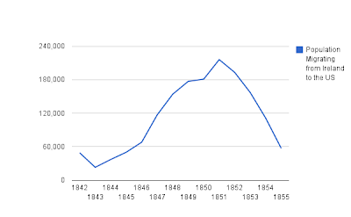
During the famine 1 million people died and 1 million people emigrated, 25 percent of the Irish population was gone because of the famine

Slide 6
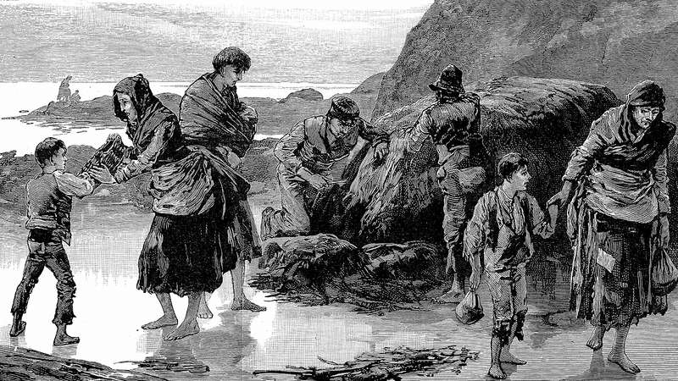

Slide 7
Language
Before the famine the main language was Irish but when the British came, they only gave jobs to people who knew how to speak English. So parents encouraged their kids to learn English that’s why our main language is English

Slide 8
Workhouses
During the famine the government opened something called workhouses. In these workhouses there would be people doing work for some food, water and a roof over their head. Everybody thought workhouses were a good place to be but it was the opposite, in these workhouses they had no night bathrooms they didn’t even have buckets so they had to go toilet outside or in a crack in the wall. In the workhouses their would be 4 different sections men, women, girls and boys so you would be separated from your family as well. During the famine there was other diseases out there so being cramped up in a room made things worse. So many people died in these workhouses that they had to put 2 people in 1 grave.

Slide 9
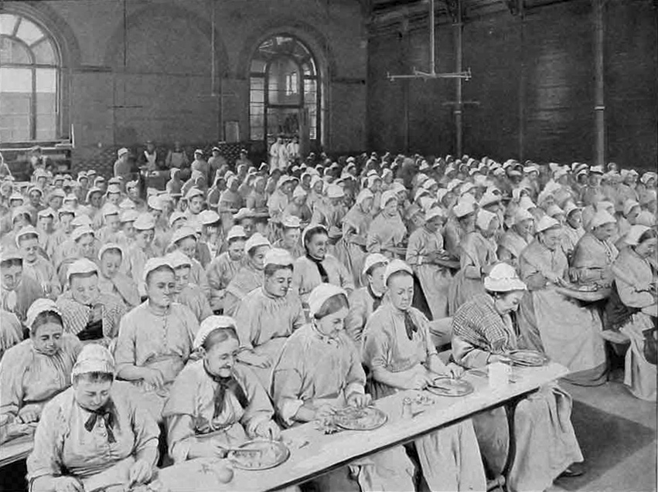

Slide 10
How did the famine end?
The famine ended in 1952 because the potato crop stopped being infected with blight and most of the population has either died or immigrated.

