Slide 1
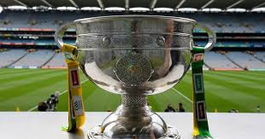
Mayo GAA

Slide 2
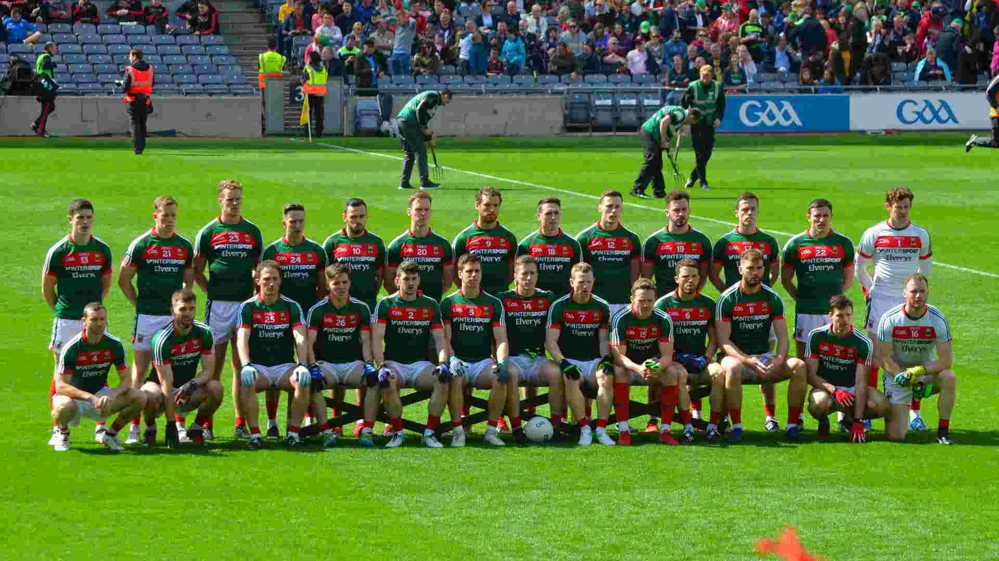
The Current Mayo Team

Slide 3
Mayo GAA Facts
There home grounds are MacHale Park in Castlebar.
Maigh Eo means plain of the yew trees.
The last time Mayo won the All Ireland Final was in 1951.

Slide 4
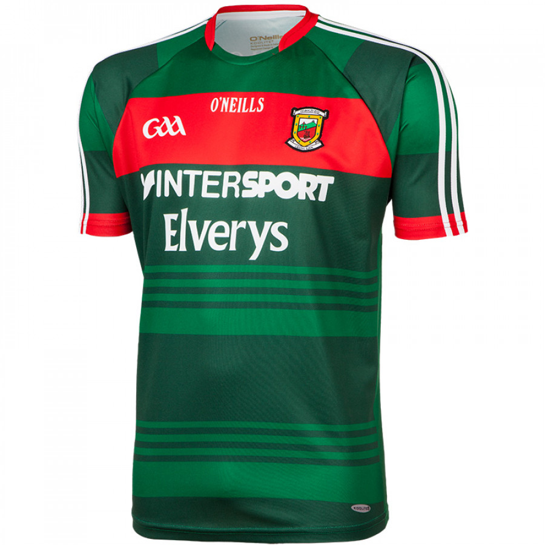
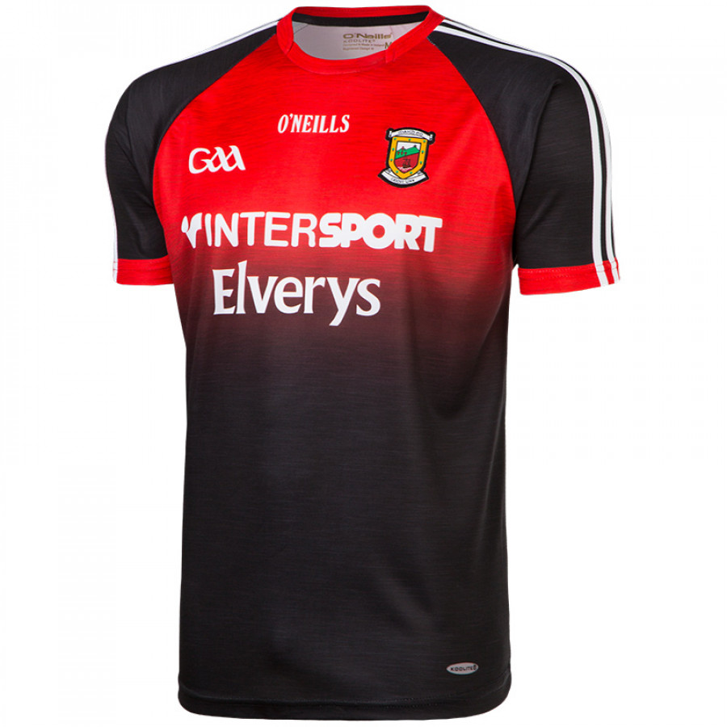
These are the Mayo jersey’s

Slide 5
AIDAN O SHEA
Aidan O Shea plays centre forward for Mayo.
He was born on the 19th of June 1990 in Ballinasloe.
His club is Breaffy and He went to collage in DIT.
He has 6 Connacht titles and
has 2 all stars inter county titles .
He has played for mayo since 2009.

Slide 6
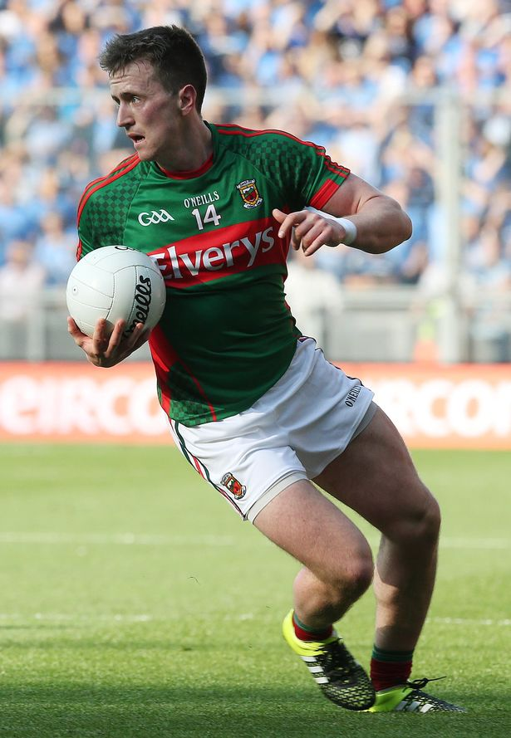
Captain
Cillian O’ Connor was born in 1992 he is 25 years old.
He is a corner forward in Gaelic football.
He is a primary school teacher and has won 3 mayo club titles.
He was born in Castlebar
and his club is Ballintubber.
He will captain Mayo v Dublin in the all Ireland final

Slide 7
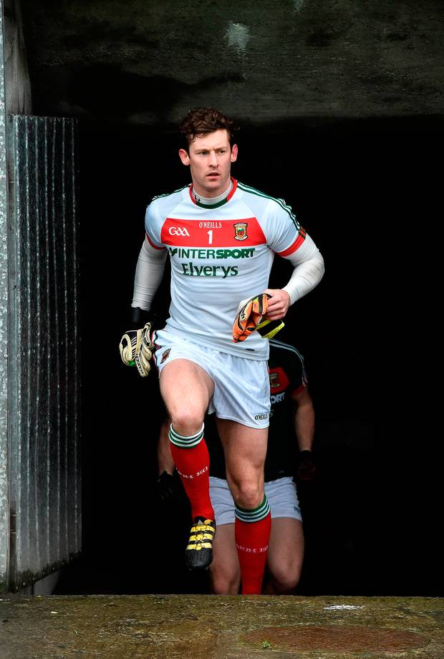
DAVID CLARKE
David Clarke is the goalkeeper for Mayo.
He has won 3 mayo club titles and 7 Connacht inter county tiles.
David Clarke is a Garda.
He was born in Castlebar in 1983.
His club is Ballina Stephenites

Slide 8
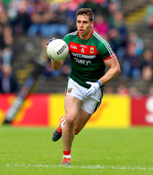
LEE KEEGAN
Lee Keegan plays right half back for Mayo.
He was born in Tramore in 1989.
His home club is Westport GAA.
He has 4 Connacht inter-county titles and 4 all stars titles.
He is 5”11.

Slide 9
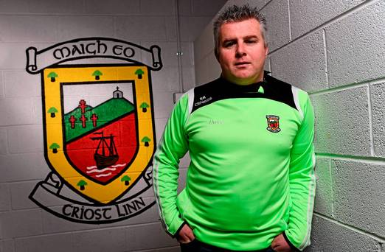
STEVEN ROCHFORD
Steven Rochford is the current manager for mayo
Steven Rochford used to play left wing back for Crossmolina.
He has gotten to 2 All Ireland’s with Mayo.
Hopefully him and his team will win the All Ireland.

Slide 10
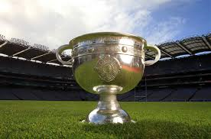
This is our Project.
Hope you enjoyed reading it
By: Finn, Kyle and Sean
MAYO FOR SAM

