Slide 1
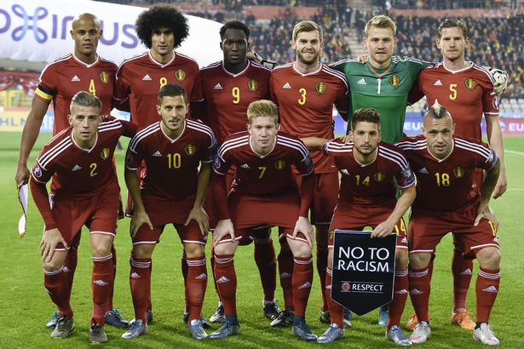
My Project on Belgium

Slide 2
GOALKEEPERS
Goalkeeper | PLD | G | YC | RC
Thibaut Courtois | 1 (0) | 0 | 0 | 0
Simon Mignolet | - | - | - | -
Jean-Francois Gillet | - | - | - | -

Slide 3
DEFENDERS
Defender | PLD | G | YC | RC
Toby Alderweireld | 1 (0) | 0 | 0 | 0
Thomas Vermaelen | 1 (0) | 0 | 0 | 0
Jan Vertonghen | 1 (0) | 0 | 1 | 0

Slide 4
MIDFIELDERS
Midfielder | PLD | G | YC | RC
Axel Witsel | 1 (0) | 0 | 0 | 0
Kevin De Bruyne | 1 (0) | 0 | 0 | 0
Radja Nainggolan | 1 (0) | 0 | 0 | 0
Marouane Fellaini | 1 (0) | 0 | 0 | 0

Slide 5
ATTACKING MIDFIEDERS
Attacking Midfielder | PLD | G | YC | RC
Eden Hazard | 1 (0) | 0 | 0 | 0
Dries Mertens | 0 (1) | 0 | 0 | 0

Slide 6
Striker
Striker | PLD | G | YC | RC
Romelu Lukaku | 1 (0) | 0 | 0 | 0
Christian Benteke | - | - | - | -
Divock Origi | 0 (1) | 0 | 0 | 0
Michy Batshuayi | - | - | - | -

Slide 7
SOCCER FACTS
Belgium's national team have participated in three, quadrennial major football competitions. They appeared in the end stages of twelve FIFA World Cups and four UEFA European Football Championships, and featured at three Olympic football tournaments, including the 1920 Olympic tournament which they won. Other notable performances are victories over four reigning world champions—West Germany, Brazil, Argentina and France—between 1954 and 2002. Belgium has longstanding football rivalries with its Dutch neighbors and its French counterparts, having played both teams nearly every year from 1905 to 1967. The squad has been known as the Red Devils since 1906; its supporters' group is named 1895.

Slide 8
General facts
Best result: runners-up 1980 Coach: Marc Wilmots Leading scorers: all-time – Bernard Voorhoof, Paul Van Himst (30); current – Marouane Fellaini (15) Most appearances: all-time – Jan Ceulemans (96); current – Jan Vertonghen (76) Association formed: 1895 Nickname: Rode Duivels/Diables Rouges (Red Devils) Where they play: Stade Roi Baudouin, Brussels

Slide 9
Tournament group
 | Played | Won | Draw | Lost | For | Against | Goal difference | Points
ITALY | 1 | 1 | 0 | 0 | 2 | 0 | 2 | 3
SWEDEN | 1 | 0 | 1 | 0 | 1 | 1 | 0 | 1
REPUBLIC OF IRELAND | 1 | 0 | 1 | 0 | 1 | 1 | 0 | 1
BELGIUM | 1 | 0 | 0 | 1 | 0 | 2 | -2 | 0

Slide 10
Qualifying group
 |  |  | Home |  |  | Away |  |  | Total
 | Teams | P | W | D | L | W | D | L | W | D | L | F | A | +/- | Pts
1 | Belgium | 10 | 4 | 1 | 0 | 3 | 1 | 1 | 7 | 2 | 1 | 24 | 5 | 19 | 23
2 | Wales | 10 | 3 | 2 | 0 | 3 | 1 | 1 | 6 | 3 | 1 | 11 | 4 | 7 | 21
3 | Bosnia and Herzegovina | 10 | 3 | 1 | 1 | 2 | 1 | 2 | 5 | 2 | 3 | 17 | 12 | 5 | 17
4 | Israel | 10 | 2 | 0 | 3 | 2 | 1 | 2 | 4 | 1 | 5 | 16 | 14 | 2 | 13
5 | Cyprus | 10 | 1 | 0 | 4 | 3 | 0 | 2 | 4 | 0 | 6 | 16 | 17 | -1 | 12
6 | Andorra | 10 | 0 | 0 | 5 | 0 | 0 | 5 | 0 | 0 | 10 | 4 | 36 | -32 | 0

Slide 11
Soccer facts
Belgium ended a 12-year absence from major tournaments with an impressive qualification for the 2014 FIFA World Cup, their surge up the FIFA rankings earning them seeded status for the finals draw, where they reached the last eight. The good times continued for Marc Wilmot's' star-studded side as they topped their UEFA EURO 2016 qualifying section. In France they will hope to match, or perhaps even better, the achievements of previous Red Devils selections. Highlights include a runners-up spot at EURO '80 and fourth place at the 1986 World Cup.

Slide 12
BY MUHAMMED

