Slide 1
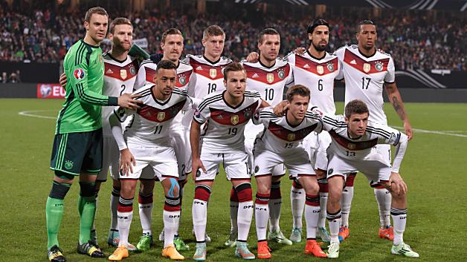
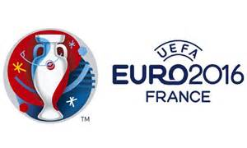
Germany in the euros

Slide 2
Euro History
These teams are the top 4 for most wins in the Euros. Germany is first.
Team | Won | Runner up
Germany | 3 | 3
Spain | 3 | 1
France | 2 | 0
Soviet Union | 1 | 1

Slide 3
Franz Beckenbauer
Franz Beckenbauer is the 4th best football player in the world.
After Zidane, Maradona and Pele. He won European best footballer of the year twice 1972, 1976.
He played in the ……..
World Cup: 1974 European Championship: 1972 European Cup: 1974, 75, 76 Cup Winners: Cup: 1967 World Club Championships: 1976 Bundesliga: 1969, 72, 73, 74. West German Cup: 1966, 67, 69, 71

Slide 4
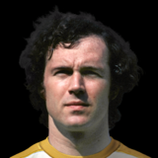
Franz Beckenbaur (2)
Bayern Munich, New York Cosmos, SV Hamburg are the teams he played for.
International Caps 103
International Goals 14

Slide 5
Germany`s table
Team | Won | draw | lose
Germany
Poland
Northern Ireland
Ukraine

Slide 6
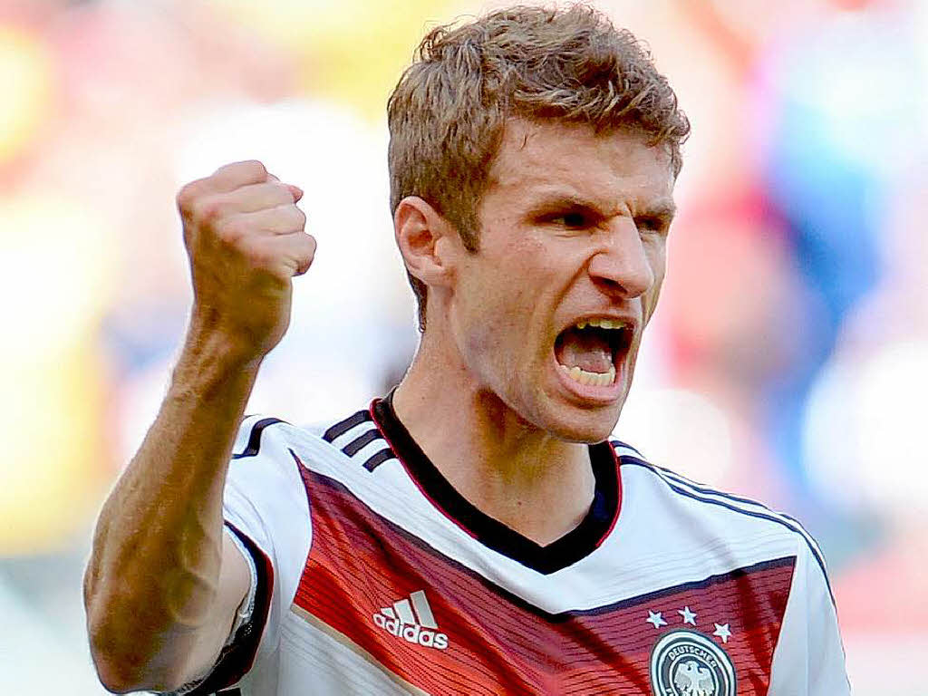
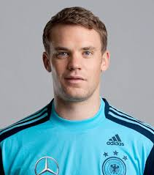
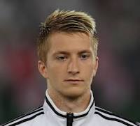
Best German Players
Born: May 31, 1989
Dortmund, Germany
Height: 1.8 m
Name: Manuel Neuer
Name: Marco Reus
Name: Thomas Muller
Born: March 27, 1986
Gelsenkirchen, Germany
Height: 1.93 m
Born: September 13, 1989
Oberbayern, Germany
Height: 1.86 m

Slide 7
Standings of the qualification
team | won | drew | lost
Germany | 7 | 1 | 2
Poland | 6 | 3 | 1
Republic of Ireland | 5 | 3 | 2
Scotland | 4 | 3 | 3
Georgia | 3 | 0 | 7
Gibraltar | 0 | 0 | 10

Slide 8
Starting 11
ST
Muller
LW
Reus
RW
Bellarabi
CM
Gundogan
CM
Kroos
LWB
Hector
RWB
Ginter
CB CB
Boateng Hummels
GK
Neuer

Slide 9
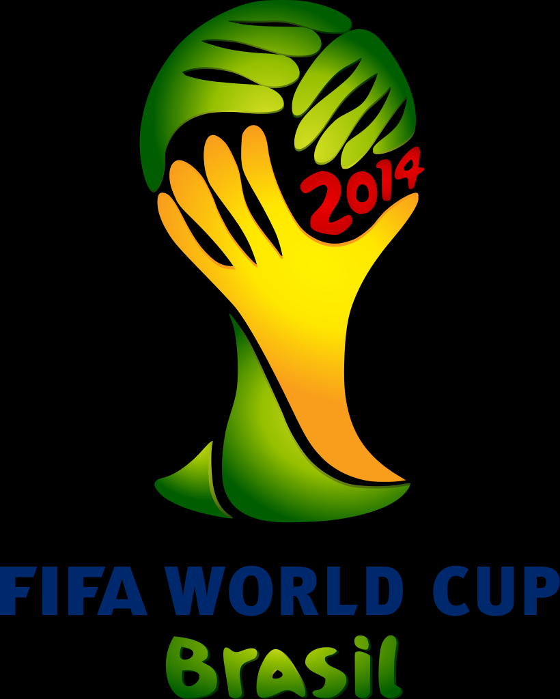
World Cup 2014
Germany won the World Cup 2014 beating Argentina in the final. The score was 1 - 0 to Germany the goal was scored by Mario Götze.

Slide 10
By: Saket Cilaveni

