Slide 1
Soccer in Ireland
By Seán Corduff
Mr. Minnocks 4th Class

Slide 2
When did it start?
Soccer started in Ireland 222 years ago thanks to John M. McAlery. John M. McAlery was a Belfast man who went on his honeymoon and saw the sport being played in Scotland.
For the first 7 years it was really only popular in Northern Ireland but then spread south, especially to the cities. There are now two football associations since the original association split up. They are called The Football Association of Ireland and The Irish Football Association. Soccer is
played throughout the country but particularly stronger in larger towns and cities.

Slide 3
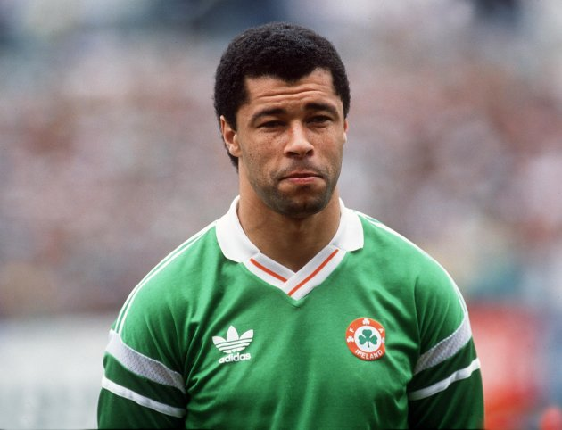
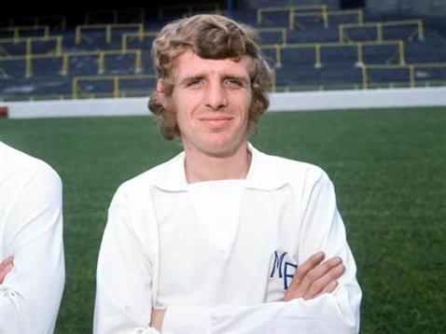
In Ireland we have had a large number of great soccer players, but because the size of our football league and financial resources many players have to cross the Irish Sea to make a living and show their talents. Over the years players like Johnny Giles, George Best, Liam Brady and Damien Duff have been very successful with their career. Other Irish soccer players include: Paul McGrath Niall Quinn Eamon Dunphy
Our Players

Slide 4
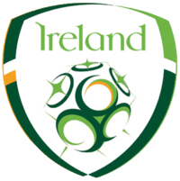
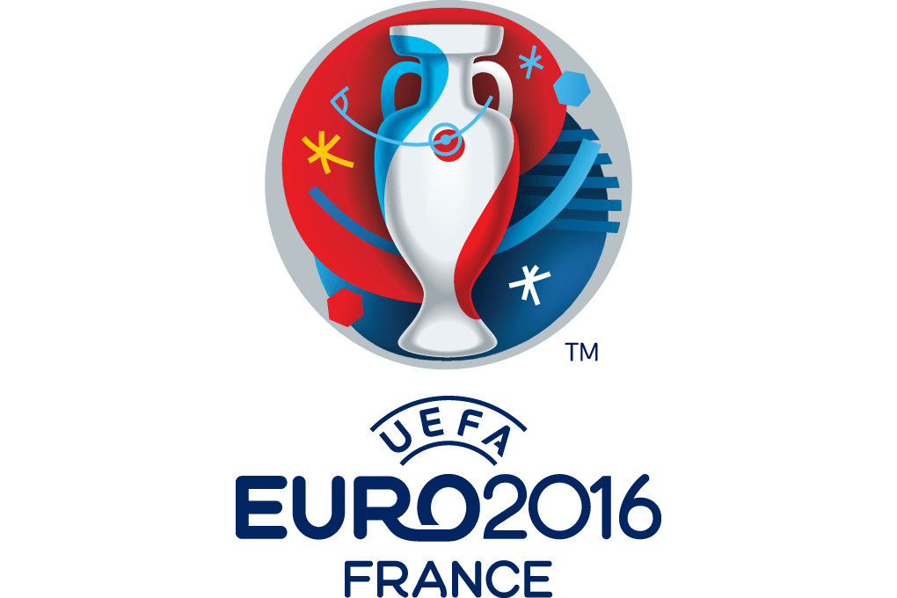
Euro 2016 Ireland

Slide 5
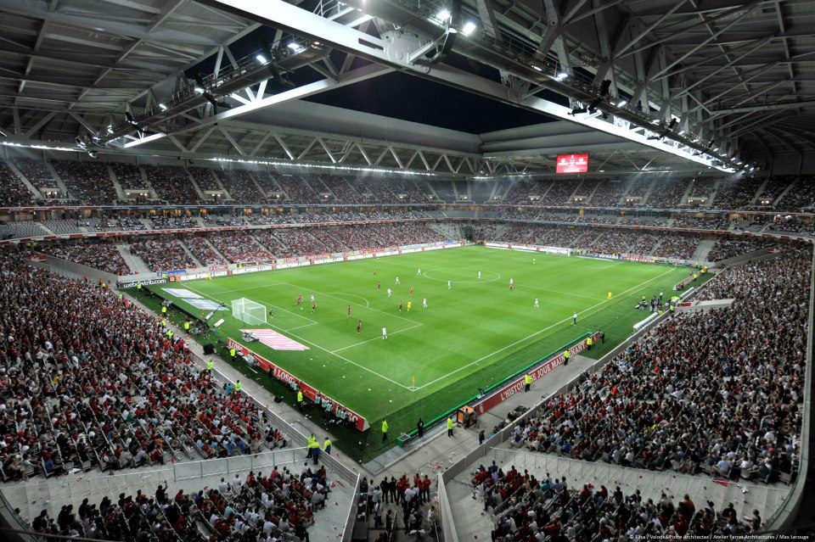
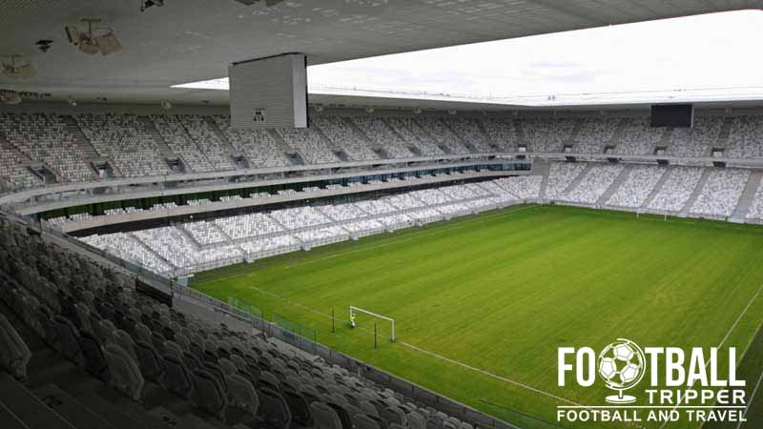
Ireland are currently competing in the Euro 2016 championship. We qualified for this championships in 2015. This is the third time we have qualified for the Euro’s. This Euro 2016 championship is taking place in France. Ireland will play their matches in Paris, Lille and Bordeaux.
Euro 2016

Slide 6
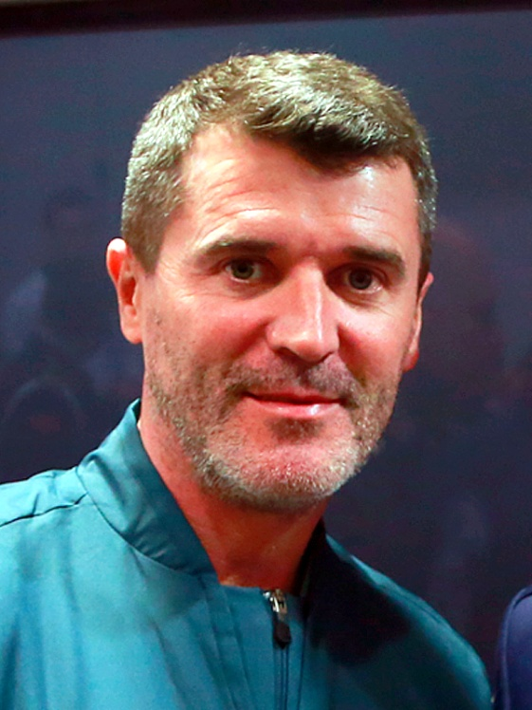
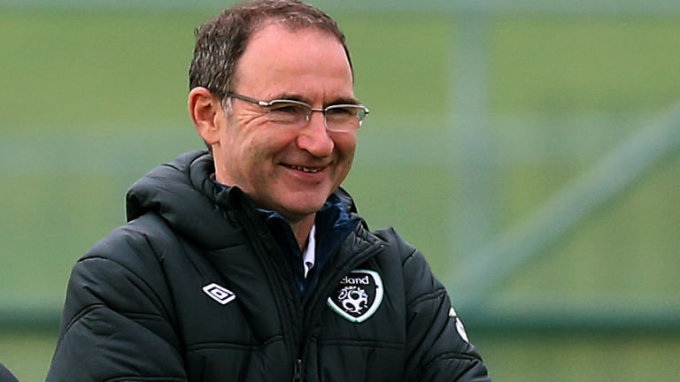
2016 Management
The head coach is Martin O’Neill. The manager’s are Martin O’Neill and Roy Keane. The captain of the Irish soccer team is Robbie Keane. Our home stadium is the Aviva in Dublin.

Slide 7
The Current Squad
Defender’s
John O’Shea, Richard Keogh, Ciaran Clark and Shane Duffy chosen as the four centre-backs. Seamus Coleman, Cyrus Christie, Robbie Brady and Stephen Ward.
Upfront: Robbie Keane, Shane Long, Jon Walters and Daryl Murphy.
Goalkeepers: Shay Given, Darren Randolph, Keiren Westwood.
Midfielders:
Aiden McGeady, James McClean, Glenn Whelan, James McCarthy, Jeff Hendrick, Wes Hoolahan, Robbie Brady, David Meyler and Stephen Quinn.

Slide 8
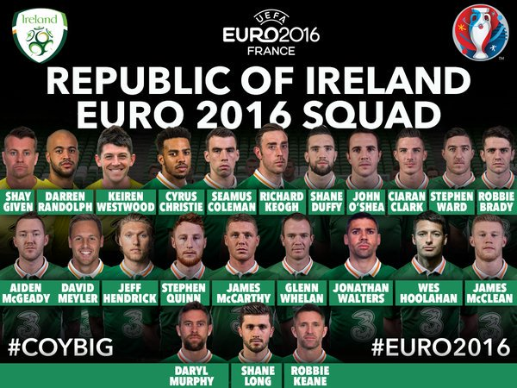

Slide 9
Ireland Euro 2016
Fixtures/Results
Ireland 1-1 Sweden
Ireland 0-3 Belgium
Ireland 1-0 Italy

Slide 10
Ireland have played Spain 25 times. This makes Spain Irelands most played team. The most amount of goals the Irish team have scored in a single match was when they beat Malta 8-0. On the 27th of May 1982 the biggest loss by the Irish football team was a 7-0 defeat the mighty Brazilians.
Did you know?

Slide 11
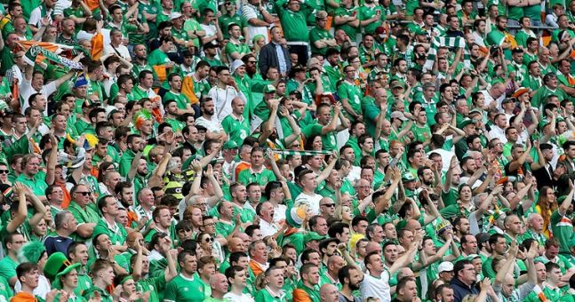
#COYBIG

Slide 12
Thank you for taking the time to read my project. I hope you enjoyed

