Slide 1
Ireland’s Great Famine 1845-1852
By Seán Clarke.

Slide 2
How It Started.
In 1840, Ireland was part of the British Empire, and a lot of poverty existed on the island at that time.
The potato was the main part of most peoples diet in Ireland because it was cheap, easy to grow and nutritious.
In late summer 1845, newspapers throughout Europe reported a previously unknown disease that was destroying the potato crop from Belgium to England.
Blight first arrived in Ireland in August 1845,where it was first recorded in Dublin’s Botanic Gardens.

Slide 3
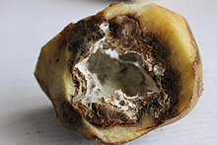
What is potato blight?
The potato blight is a fungus that spreads through the air and is most deadly when weather conditions are warm and humid.
Blight is fast acting, and is able to wipe out a full crop overnight.
The blight also attacks stored potatoes causing them to decay rapidly.

Slide 4
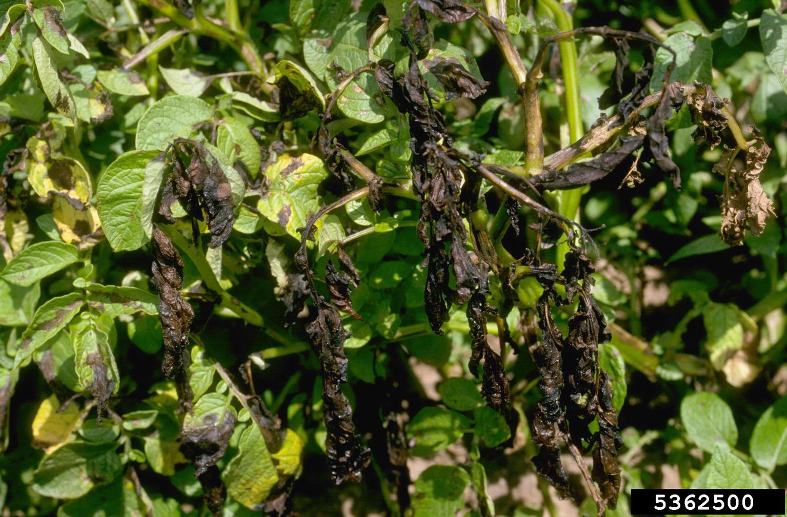
How blight affects the potato.
Blight affects the leaves on the plant, the leaves act as solar panels. Blight makes the leaves dry up and unable to take in light and water causing the crop to die.
When a crop is affected by blight it would almost look like the crop has been burned.

Slide 5
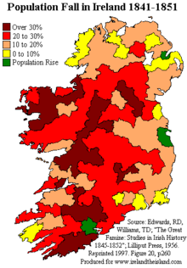
Population of Ireland.
Over 3 million people either died or emigrated during the Great Famine.
In 1841 the population of Ireland was 8.2 million.
In 1851 the population of Ireland was 6.6 million.
Because of the crop failure most Irish families could not pay rent on their home. Little help was given by landlords or the British Government.
Most families had 2 choices, to either emigrate or go to the Work House.

Slide 6
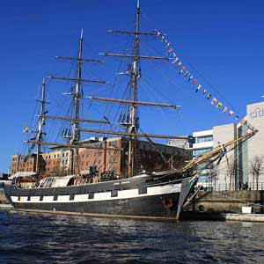
Emigration.
Most people that left Ireland emigrated to Canada, England or North America.
The ships were named “coffin ships” because of the poor hygiene standards and death rate on board due to disease and hunger.
The Jeanie Johnston was a ship built in Quebec Canada in 1847.
She transported two thousand five hundred people from Ireland to North America in over 16 voyages.

Slide 7
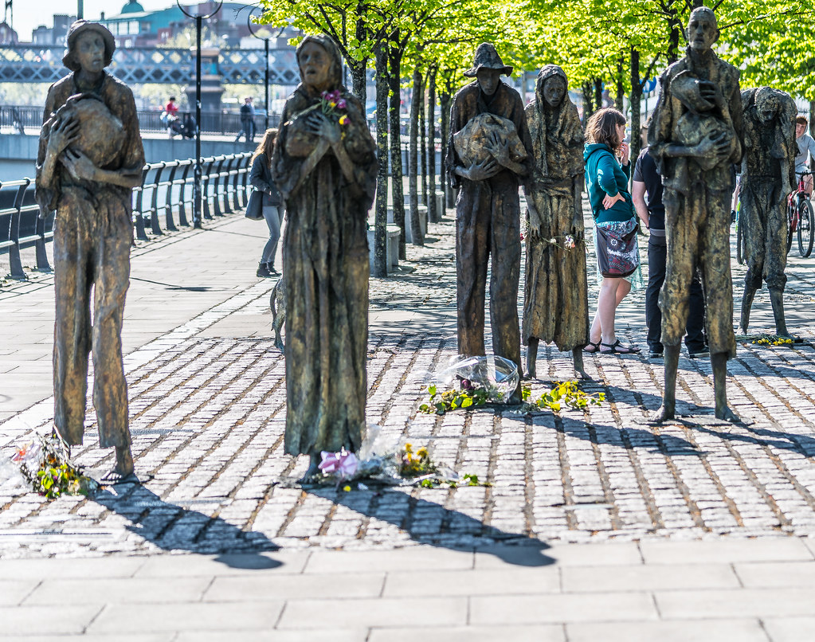
Public Works.
Sir Robert Peel set up the public works programme.
The Public Works was a place you could go and get a little bit of money if you had no other way of earning it.
The work given was in most cases useless.
The things they built were…roads, walls, piers and useless structures.
People who lived in rural areas had to often move to towns and cities because of eviction. Because of the poverty in the cities food riots and crime increased.

Slide 8
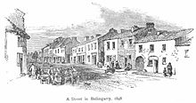
Irish Rebellion.
Many Irish people had the view that they had to free themselves from British rule in order to overcome the famine.
A group called the Young Irelanders formed the Irish Confederation.
The Young Irelanders refused to rule out the possibility of using force to free Ireland from Britain.
In 1848 in Waterford, the Irish flag was flown for the first time. A rising was also attempted in Tipperary, but was quickly defeated.

