Slide 1
Football in Germany
you enjoy Today I will be showing you my project about football in Germany I hope y my project

Slide 2
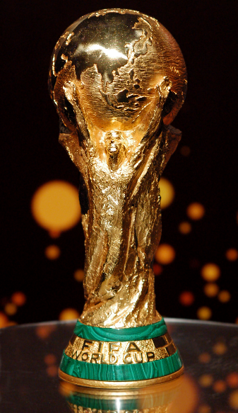
facts
Here are 5 facts about football in Germany
1 Germany has won 4 world cups
2 Germany has been runner up three time in the European championship
3 There are183 clubs in Germany 4 Germany is the only nation that won the men's and women's world cup
5 Germanys has the highest elo rating with a record of 2200

Slide 3
Bets wins from Germany
In 2014 world cup semi finals Germany beat brazil with a 7-1 win
In 1908 Germany play Switzerland in there first international and beat them 5-3

Slide 4
Germanys team
1 Manuel Neuer 13 Thomas Muller
2 Shkodran Mustufi 17 Jerome Boateng
3 Jonas Hector 18 Toni kroos
4 Benedikt Howedes 19 Mario gotze
6 Sami Khedira 7 swinstiger
8 Mesut ozil coach Joachim low
11 Julian Draxaler

Slide 5
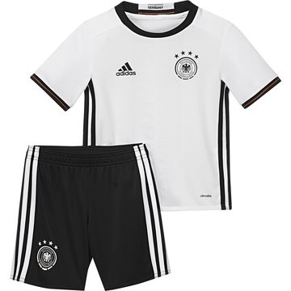
Team colours
Germanys team colours are whit shirt and black shorts

Slide 6
chances

Slide 7
Thank you for reading my project
Thank you for your time
By temi alao

