Slide 1
The irish Famine
By Fionn Vennard.

Slide 2
How the famine stared
The famine started in 1845 and ended in 1849.
There were many factors that caused the famine but the main factor was potato blight.

Slide 3
what was the main source of food for the irish people in 1845
The majority of Irish people survived on potatoes.

Slide 4
where did the famine start
The famine started in west Connacht.

Slide 5
How many people died
One million people died and one million people emigrated.

Slide 6
population decrease
The famine caused the Irish population to decrease by 25%.

Slide 7
Facts
The Irish famine was the worst famine in Europe during the 18th century.

Slide 8
Facts
Some people believed that the British wanted to genocide the Irish because they didn’t help the Irish.

Slide 9
Facts
There were many evictions during the famine

Slide 10
Facts
Matters could have been handled better if the British had closed the ports.

Slide 11
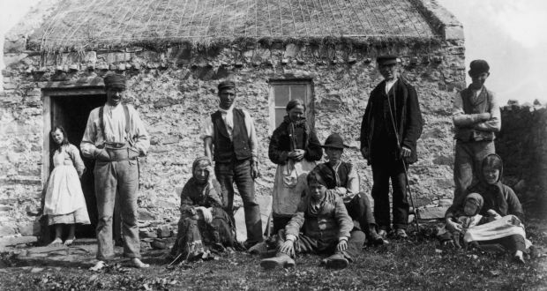
Pictures during the irish famine
These are some people during the Irish famine

Slide 12
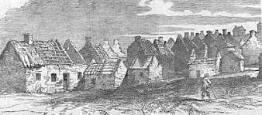
Pictures during the irish famine
This is a picture of a village during the Irish famine

