Slide 1
Tour of europe
challenge
European week of sport
22nd-30th september

Slide 2
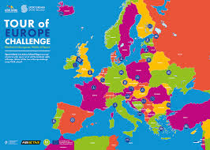

Slide 3
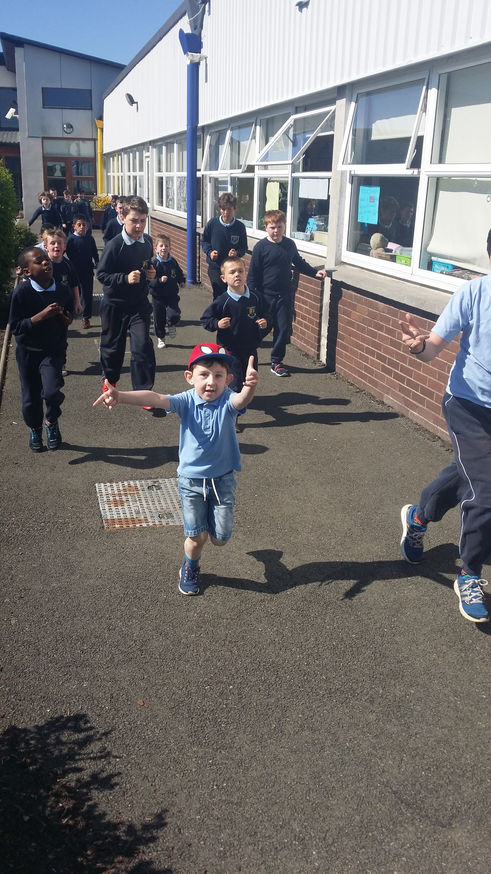
Laps
Each class run laps everyday
1 Lap= 330 m
2 Laps= 660m
3 Laps= 1km

Slide 4
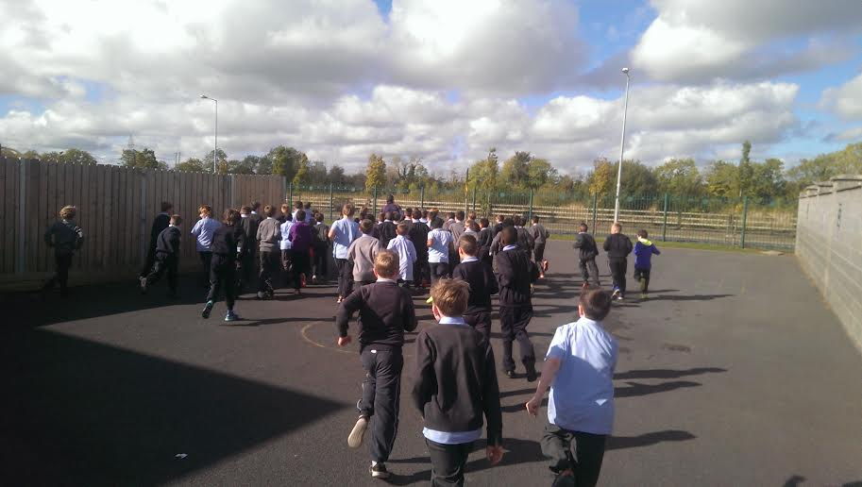
Amount of Laps Each Class Run
Senior Infants= 1 lap
1st class= 1 Lap
2nd class= 2 Laps
3rd class= 3 Laps
4th class= 4 Laps
5th class= 5 Laps
6th class=6 Laps

Slide 5
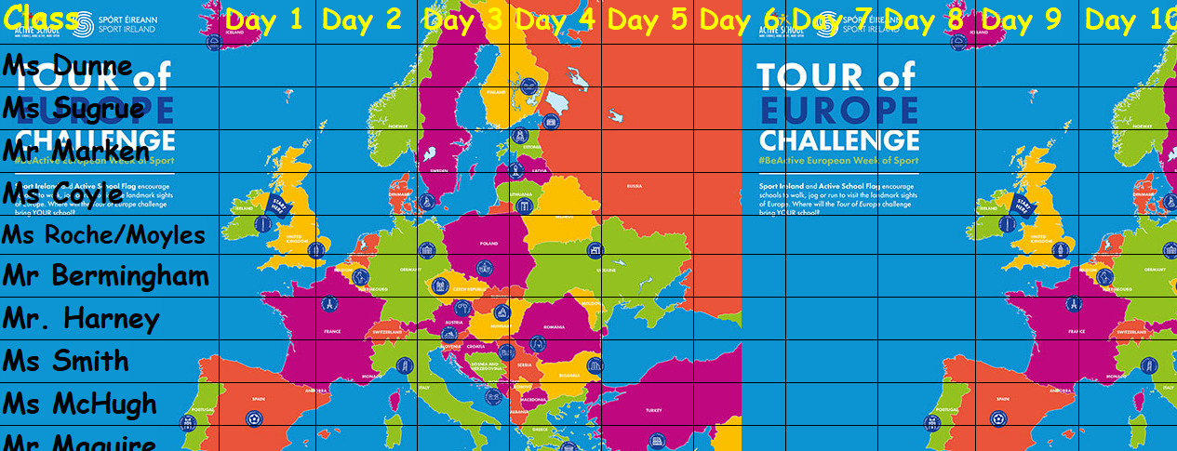
Daily Record

