Slide 1
United Arab Emirates
By Gowtham sai dasari

Slide 2
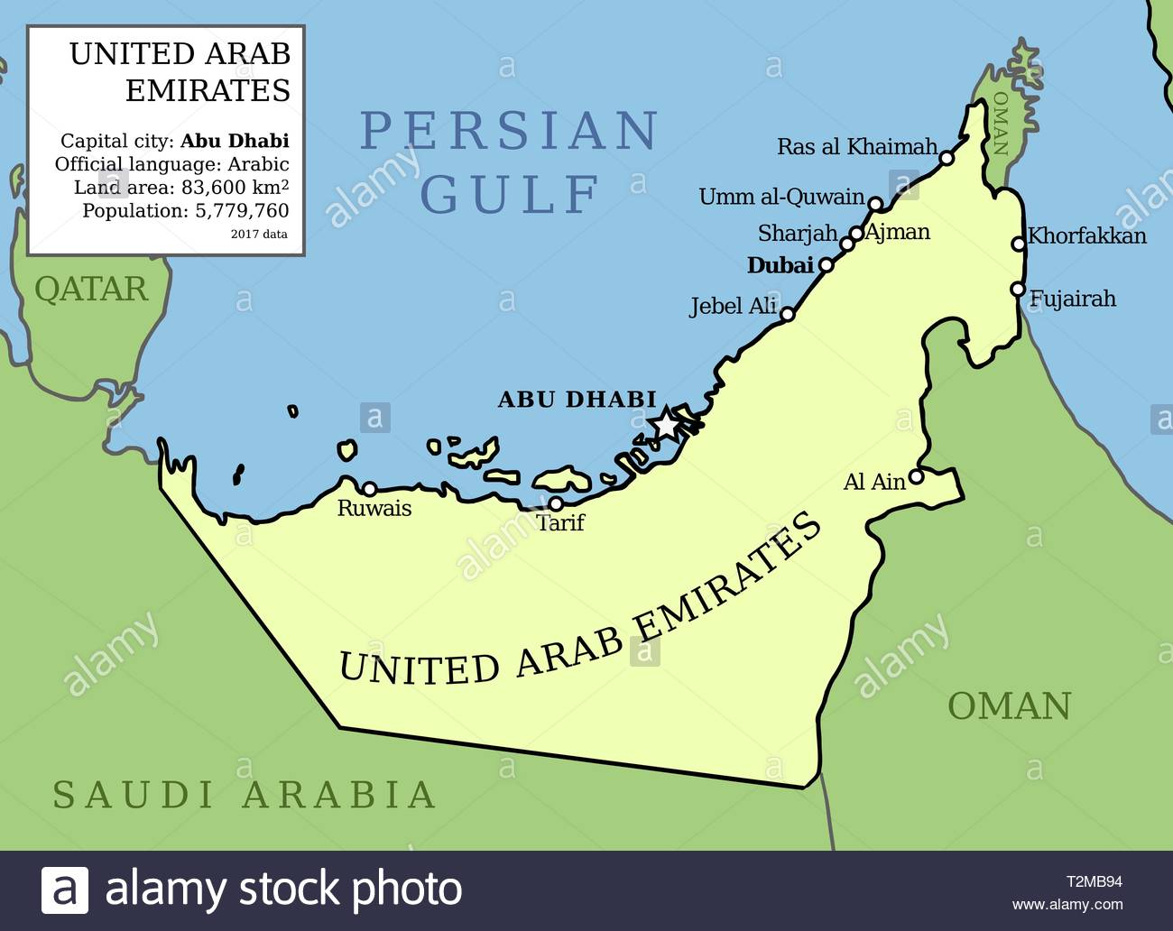
This is where United Arab Emirates is located

Slide 3
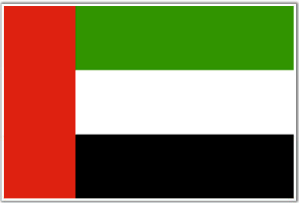
This is the UAE flag
The capital city of the UAE is Abu Dhabi

Slide 4
The United Arab Emirates consists of seven independent city-states
Abu Dhabi
Dubai
Ajman
Fujairah
Ras al Khaimah
Sharjah
Umm al Quwain

Slide 5
Language, Currency and Natural Resources
‘ Arabic’ language is spoken and its alphabet has 28 letters and is written from right to left.
The currency that Arabic people use in the UAE is called dirhams. A 500ml water bottle is 1 dirham. One dirham is 0.23 cents.
The UAE's natural resources are natural gas and oil.

Slide 6
Religion and culture
In the UAE 76% of people are Muslim and 19 percent are Christian.
The traditional dress worn by Emirati men is called khandura, a white long tunic, while women usually wear the abaya, a black garment covering the whole body and head.
The native language is Arabic. People in UAE are very religious and love their culture and have very strict rules some examples are that only married couples can stay in hotel rooms and any crimes like stealing will result in your hands getting chopped off as a punishment.
Smoking is not allowed in government areas

Slide 7
History Of UAE
UAE/United Arab Emirates was founded in December 2nd 1971 before December 2nd 1971 all the seven cities were actually separate places so Abu Dhabi, Dubai, Ajman,
Al Fujayrah , Sharjah and Quwayn were all different places. Sheikh Zayed bin Sultan Al Nahyan was the founder and father of UAE

Slide 8
UAE FOOD AND DRINK
This is a Shawarma, it is one of the staple foods of UAE. It is a meat wrap that can vary between different meats. So in simple English it’s a wrap with different meat and different vegetables in it

Slide 9
UAE street food
Tawook is rolled inside pita bread along with hummus, pickles, and pickled turnips.

Slide 10
GAHWA
Gahwa is a UAE drink normally served with dates. It is basically a UAE style of coffee.

Slide 11
LABAN
Laban is a yogurt/dairy beverage widely served across UAE it has many health benefits and is very healthy. Sometimes people add mint to it to make it taste minty.

Slide 12
FAMOUS TOURIST ATTRACTOINS
In the UAE there is loads of monuments and tourism places.
In Dubai there is a Ferrari amusement park it has the fastest roller coaster it can go from 0 kmh to 240 kmh in 4.9 seconds.
It also has the tallest building/skyscraper in the world called the Burj khalifa it is 2772 ft tall

Slide 13
TOURIST ATTRACTOINS
This is a birds eye view picture of Dubai’s manmade archipelagos two of them are shaped like palm trees and one to resemble the world map.

Slide 14
UAE GOLD
UAE is known for its fabulous jewellery and gold collections they have a vast collection of items.
They are also known for a mall in Dubai it says to have all the clothing brands under one roof!

Slide 15
Sports
Famous Sports in UAE are:
1) Football: Football or soccer is one of the most popular sports played in the UAE. ...
2) Cricket
3) Horse Racing
4) Tennis
5) Motor Sports
6) Camel Racing
7) Golf
8) Basketball

Slide 16
The end

