Slide 1
World War 1
By: Jack O’Shaughnessy

Slide 2
Contents
1. How the war began
2. Alliances
3. Deaths and Injuries
4. weapons
5. Impact of WW1
6. Facts

Slide 3
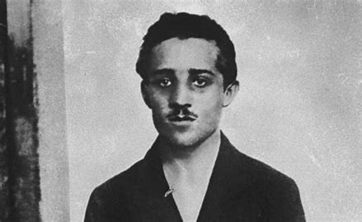
How the war began
The war began after the assassination of Archduke Franz Ferdinand, he was killed by a man called Gavrillo Princip who was in a Serbian terrorist group called the Black Hand.
Archduke Franz Ferdinand was the heir to the Austro – Hungarian Empire.
The murder of Archduke Franz Ferdinand outraged Austria-Hungary, Austria Hungary was furious and with Germany’s support declared war on Serbia on the July 28th 1914.
Within days Germany then declared war on Russia who was an ally of Serbia and invaded France via Belgium which then caused Britain to declare war on Germany

Slide 4
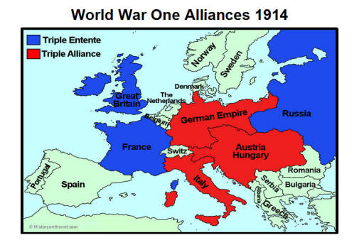
Alliance
In 1914 Europes six major powers were split into two alliances that would form the warring sides in World War 1.
Britain, France and Russia formed the Triple Entente.
Germay, Austria – Hungary and Italy formed the Triple Alliance.

Slide 5
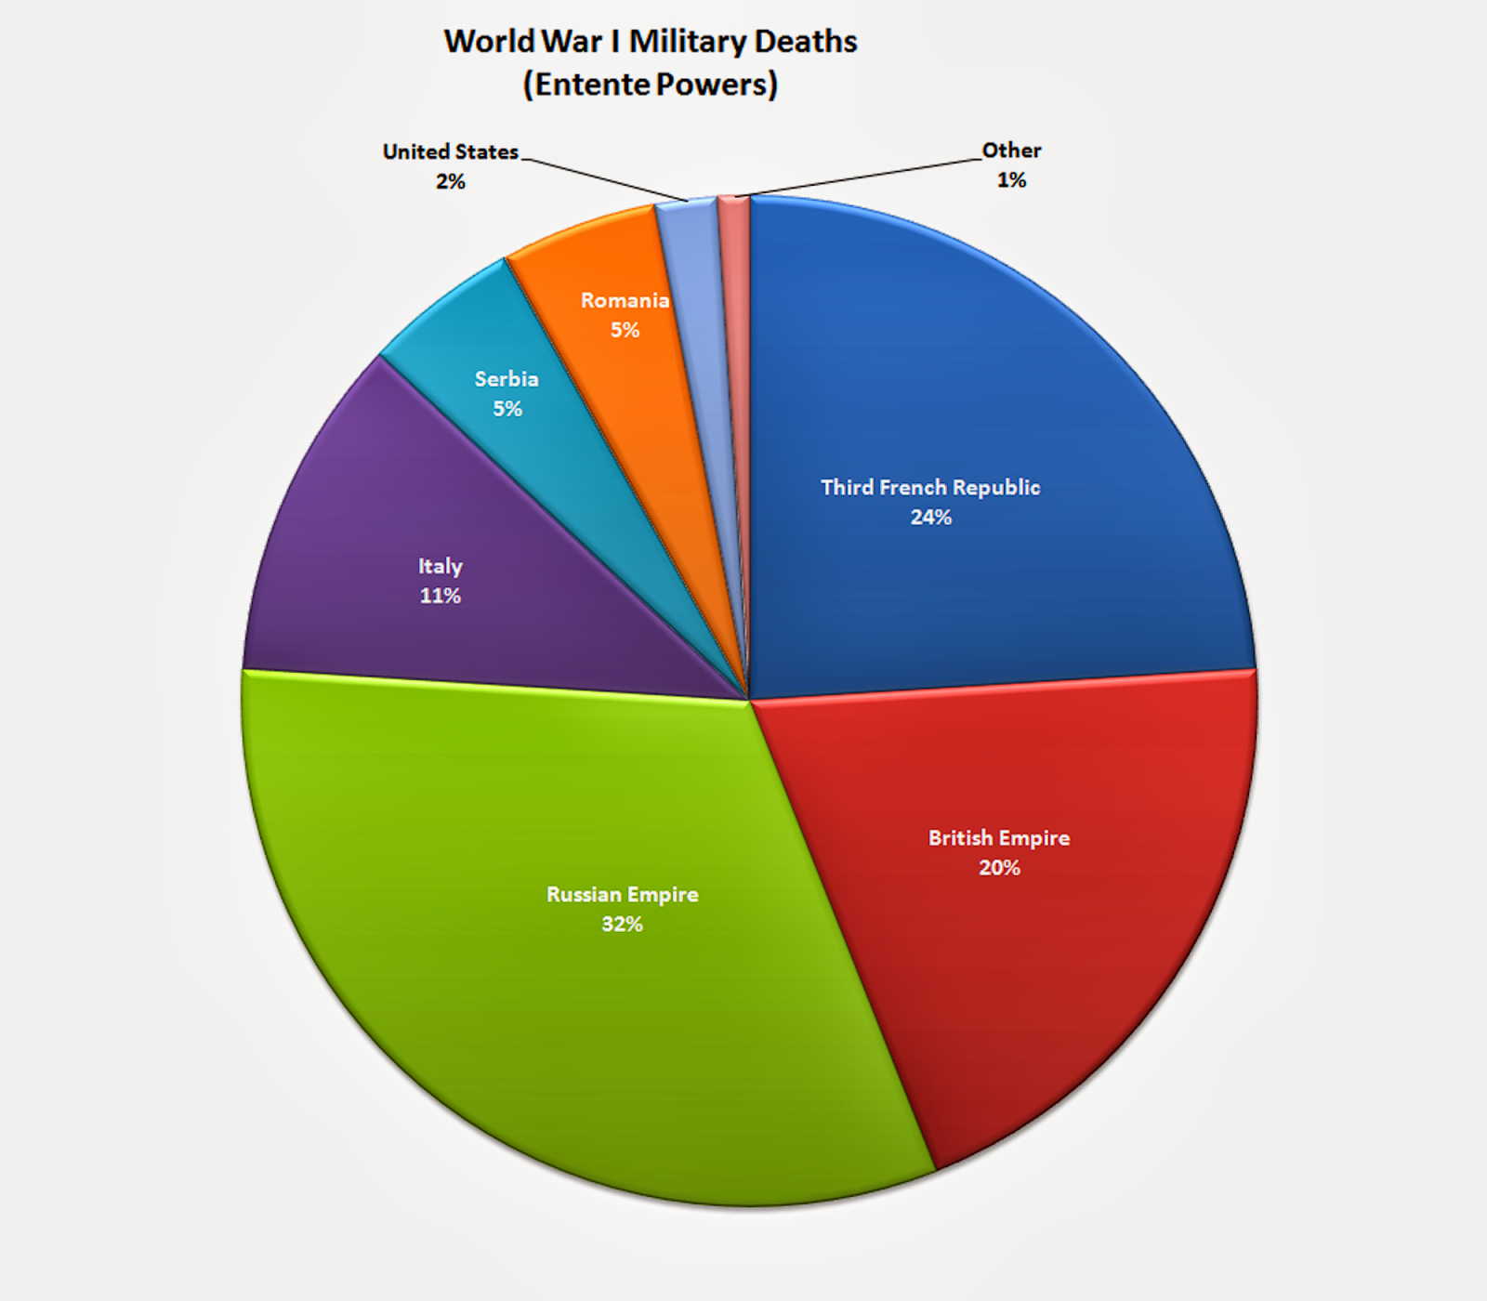
Deaths and injuries
In England around 1 million soldiers and citizens died
In Belgium 130,000 soldiers and citizens died
In France 1.6 million soldiers and citizens died
In Italy 1.1 million soldiers and citizens died

Slide 6
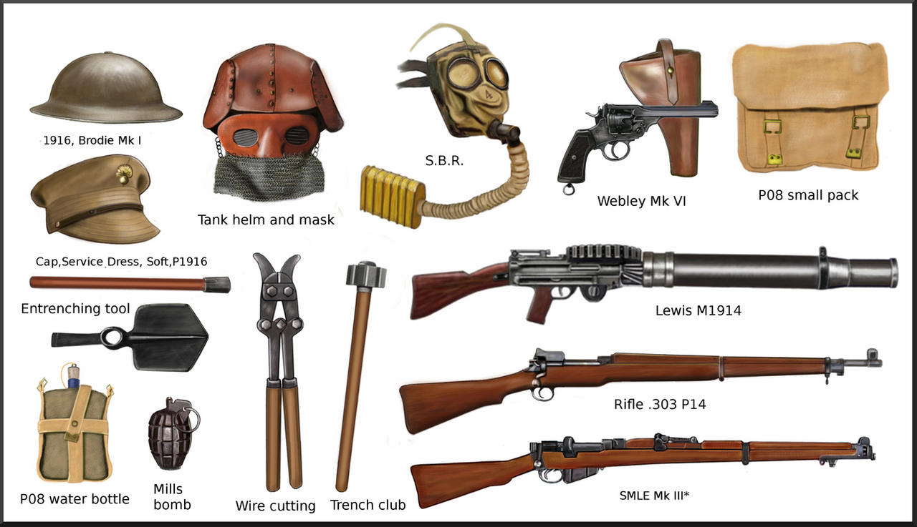
Weapons
Artillery was the most affective destructive weapon on the Western Front. Guns could rain down high explosive shells, shrapnel and poison gas on the enemy and heavy fire could destroy troop concentrations, wire and fortified positions.
Artillery was often key to successful operations.

Slide 7
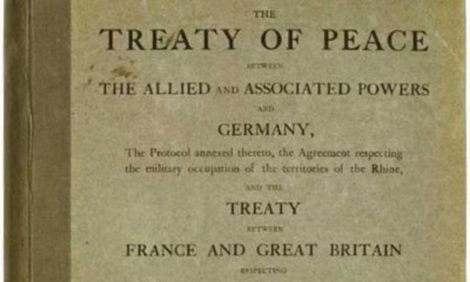
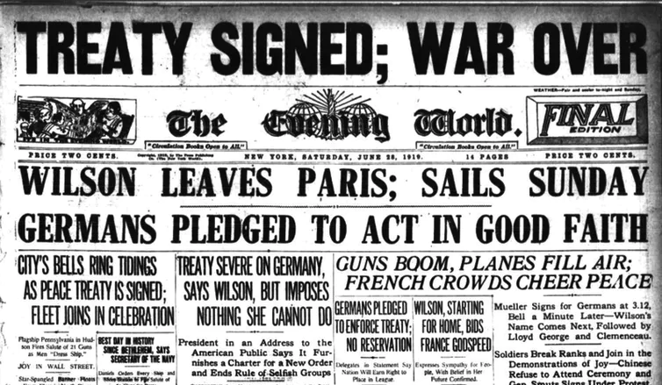
Impact of WW1
WW1 boosted research in Technology because better transport and means of communication gave countries an advantage over their enemies.
WW1 destroyed empires and created new nations, encouraged European colonies to seek Independence, forced the United States to become a world power and led to Soniet communism and the rise of Hitler.
Germany surrendered on November 11th 1918, all nations agreed to stop fighting until a peace agreement was negotiated.
On June 28th 1919 all Allied Nations signed the Treaty of Versailles.

Slide 8
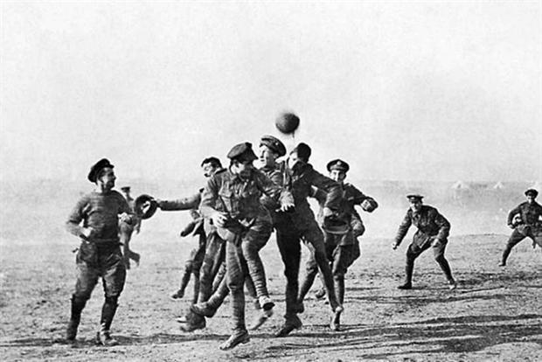
Facts
A bomb that went off in in France was heard in England.
The youngest soldier that went to war was an English solider who was only 12 years old.
12 Million Letters were sent from family's of soldiers who had went to war.
An unofficial truce was called on Christmas 1914 – from December 24th to 26th , Men played football with one another creating one of the most memorable images of the truce.

