Slide 1
World War 1
by : Joseph gavin

Slide 2
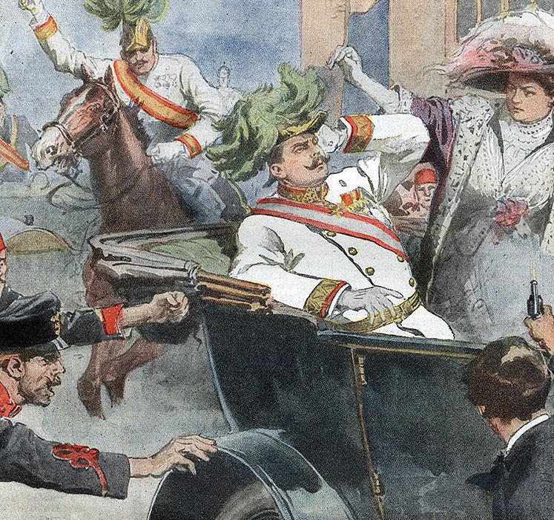
The first shots fired….
The first shots were fired at archduke Franz Ferdinand of Austria by a nationalist while on official business to the Bosnian capital.
It sparked a series of killings that was the driving force in the start of world war 1.

Slide 3
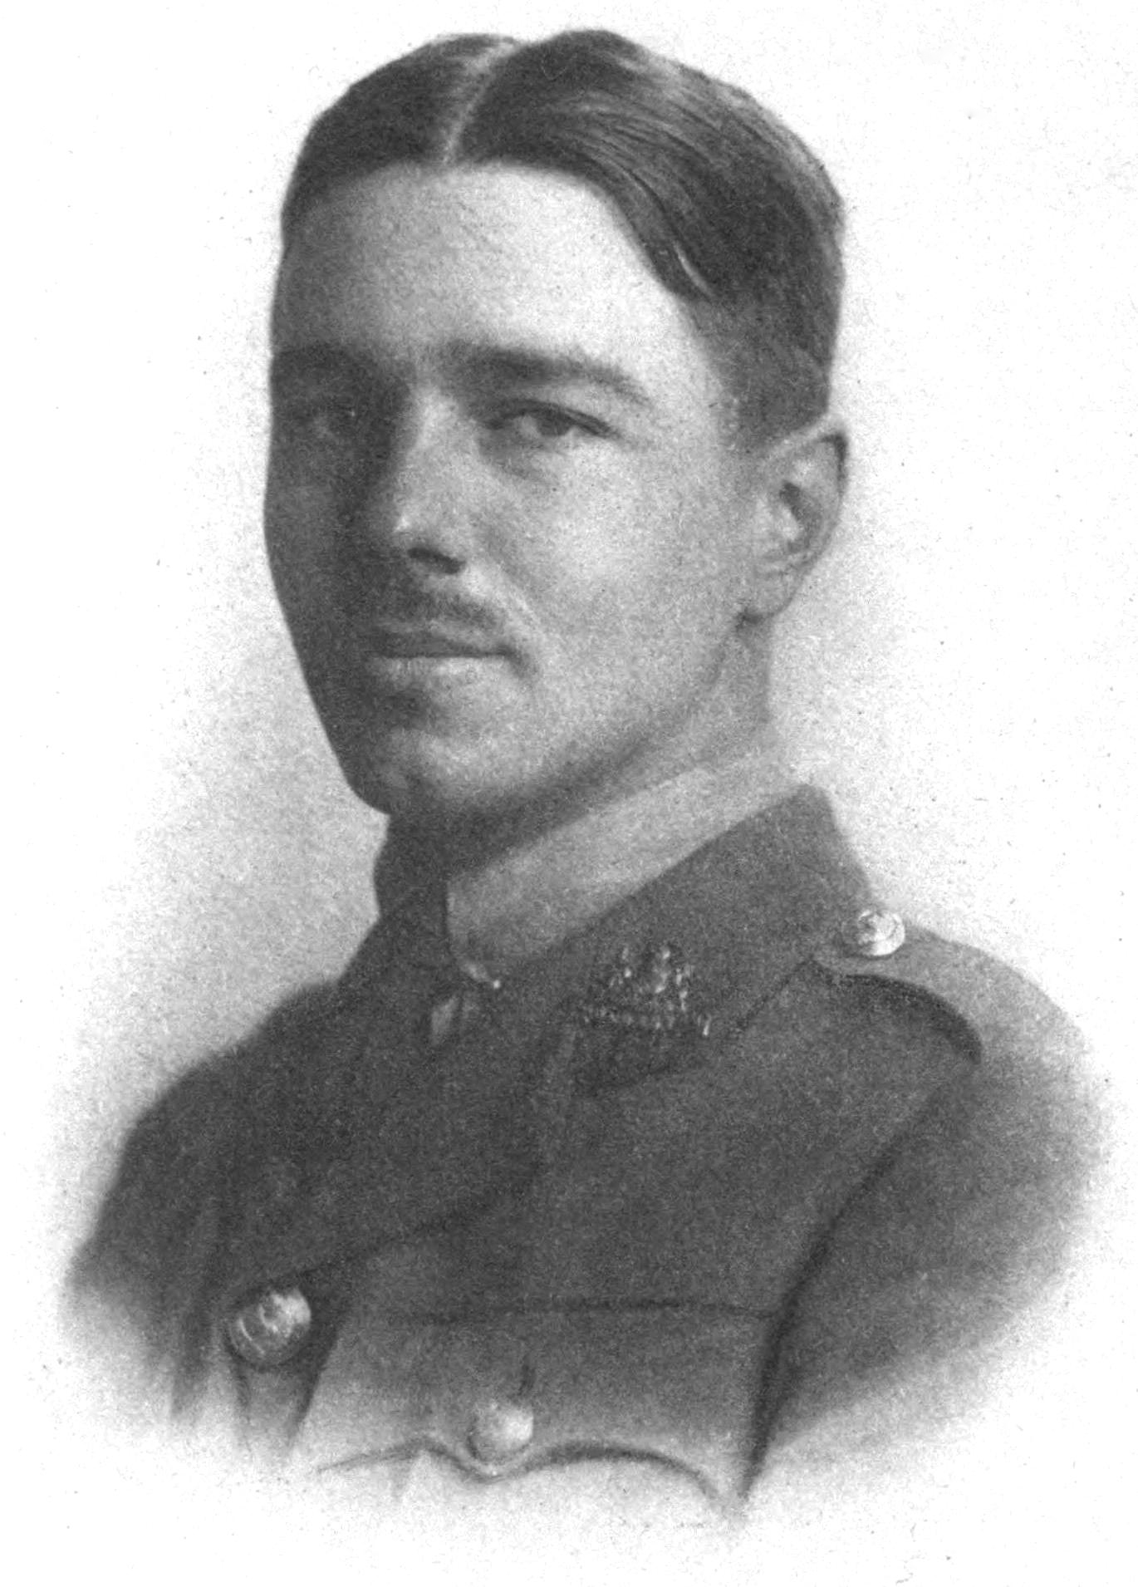
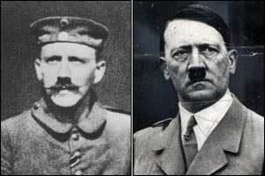
The Great War
< Wilfred Owen
World war 1 was nicknamed the great war, the war to end all wars, but in the end, they decided to have another war.
Alot of famous and infamous people in history made their first appearance in world war 1, such as Wilfred Owen the poet of dulce et decorum Est, and Hitler ( who unfortunately didn’t die in the trenches)

Slide 4
Dulce et decorum Est - latin for it is sweet and honourable

Slide 5
Ireland in 1914
What goes unnoticed is the fact that many irish men played a huge part in the war regardless of the civil war and the 1916 rising.
In all about 210,000 Irish men served in British forces.
Some 35,000 Irish died

Slide 6
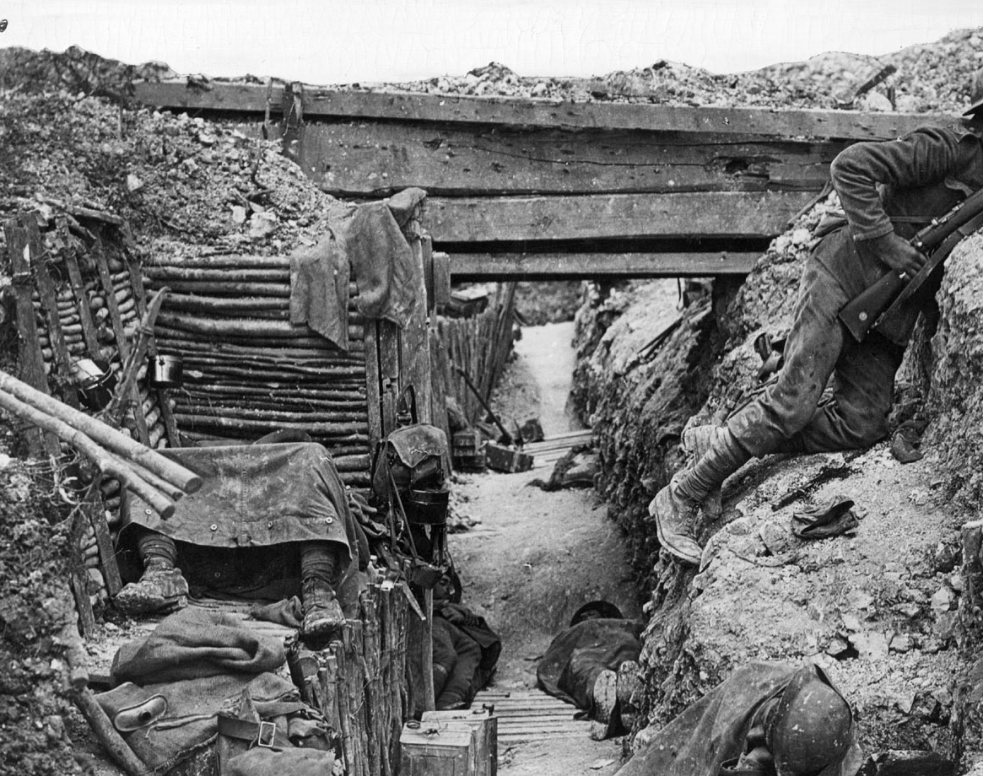
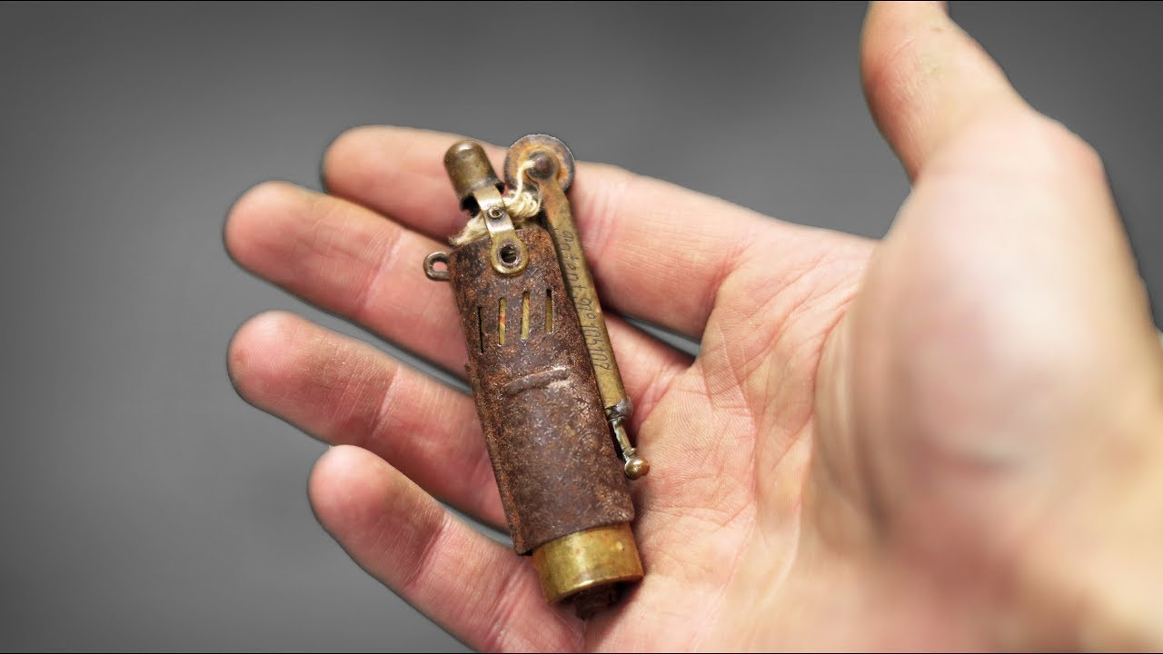
war objects

