Slide 1
TRINIDAD AND TOBAGO PROJECT

Slide 2
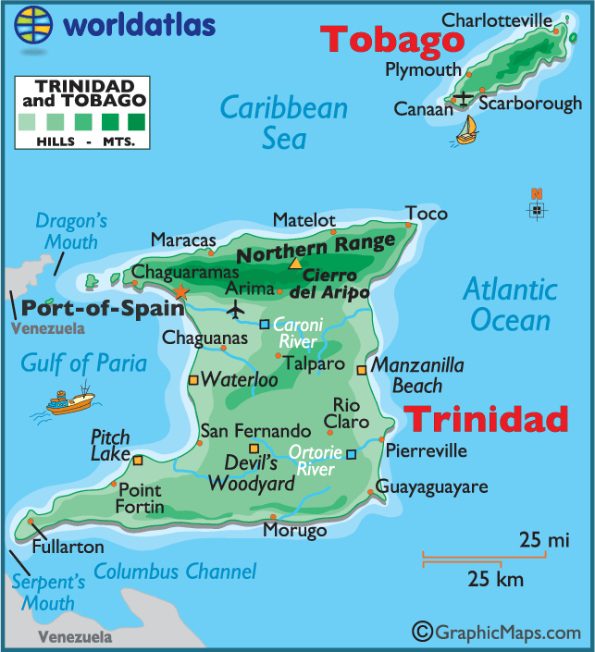
LOCATION
The Republic of Trinidad and Tobago is a nation in the South Caribbean Sea. It lies close to the continent of South America Northeast of Venezuela and Northwest of Guyana. The country has two bigger islands called Trinadad and Tabago and it has smaller islands too.

Slide 3
LANGUAGE AND RELIGON
Languages spoken are English (official) ,Hindi, French, Spanish and Chinese.
Trinadad and Tabago is diverse. It has people of many different races and religons. There are people who are children of Africans Europeans Arabs Indians and Chinese who moved to the island a long time ago. The biggest religons in the country are Christiananity and Hinduisim .There are also Islam and African religons in the Country .

Slide 4
HISTORY
The original settlers to the islands were the Native American Arawak and Carib tribes. When the Europeans arrived, the locals were nearly wiped out by disease.
The first European too arrive at Trinidad was Christopher Columbus in 1648. He named the island and 100 years later the Spanish came and settled in the area. The English took possession of Trinidad in 1797 ,but Tabago changes hands numerous times between the French , English , and Dutch before the English finally took and made it a colony in 1803. Kingdom in 1962 . It became a republic in 1976.

Slide 5
CLIMATE AND GEOGRAPHY
The climate is tropical with high relative humidity . The coolest months are January February when the average temperature is about (20 c) . The warmest months are April May and October which have an average temperature is about 89F (32C).
Tobago is mountaineous and dominated by the main ridge. There are deep, fertile valleys north and south of the main ridge. The SouthWest tip of the Island has a coral platform. Tobago is volcanic in origin, but there are no active volcanoes.
The coastline is indented with numerous bays, beaches, and narrow coastal plains.

Slide 6
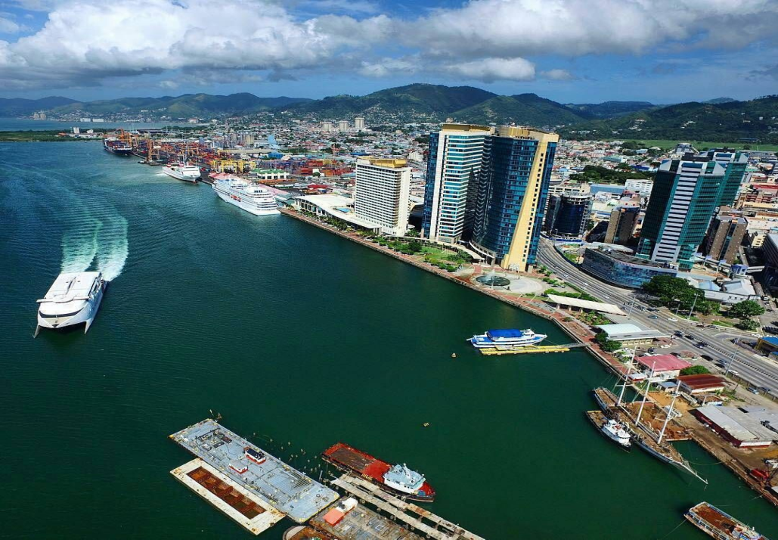
CAPITAL AND POPULATION
The Country has about 1,262,366 People in their Country. The capital is Port of Spain.

Slide 7
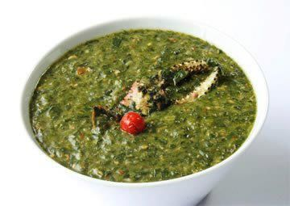
FOOD AND SPORTS
The most popular in Trinidad and Tobago is Cricket. Other popular sports are football and basketball.
Their cuisine consists of a fusion of African, Chinese, Indian South-Asian, and Latin American – Spanish – Portuguese Cuisine.

Slide 8
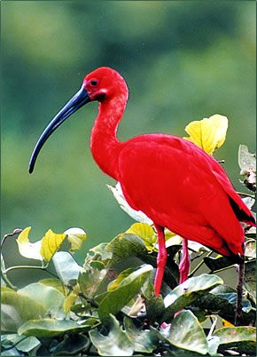
PLANTS AND ANIMALS
Tropical rain forests grow in the high areas. The island’s animals include golden tree frogs, porcupines, armadillos, wild pigs and rodents. The scarlet ibis is the country’s national bird.

Slide 9
ECONOMY - IMPORTS AND EXPORTS
Major Imports: machinery, transportation equipment, manufactured goods, food, live animals
Major Exports: Petroleum and petroleum products, chemicals, steel products, fertilizer, sugar, cocoa, coffee, citrus, flowers.
Major Industries: petroleum, chemicals, tourism, food processing, cement, beverage, cotton textiles.
Natural Resources: Petroleum, natural gas, asphalt.
Agricultural Products: cocoa, rice, citrus, coffee, vegetables, poultry
Currency: Trinidad and Tobago (TTD)

