Slide 1
FIJI
By Aaron Mulcahy

Slide 2
This is Fiji, it is in the South Pacific Ocean. It has 330 islands in its power and only 110 are inhabited

Slide 3
The capital of Fiji is Suva,the population of Suva is about 176,000 from the last census in 2014. Suva’s Kings Wharf is the site for much of its country’s shipping industry. Fiji exported US $926.1 million in 2016 alone!

Slide 4
Fijis waters are home to around 1,500 marine life species.
The two major island (Viti Levu and Vanua Levu) account for 87% of the Fiji islands population
Fiji is home to more than 4,000 square miles of coral reef including the great Astrolbe
Fijis total land mass is just smaller than the state of New Jersey

Slide 5
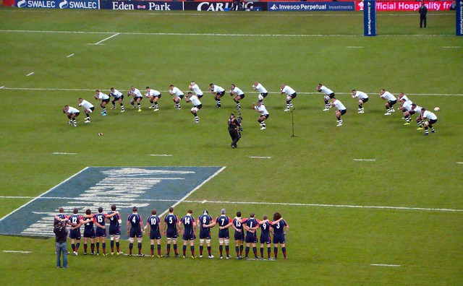
RUGBY WORLD CUP GO FIJI
Here is a little clip af the Fijian haka
The main sport in Fiji is rugby but others also include netball and soccer
This is a picture of Fiji doing their haka

Slide 6
This is the Fiji rugby team. This is them doing the Fijian haka

Slide 7
The Fijian language
Bula is the famous greeting in Fiji it goes well past the simple hello it literally means life
The word moce means goodbye in Fiji
Lako means go
And vinaka means thank you

Slide 8
I HOPED YOU ENJOYED MY PROJECT ON FIJI

