Slide 1
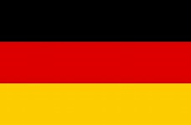
Germany
By: Jack O’ Shaughnessy

Slide 2
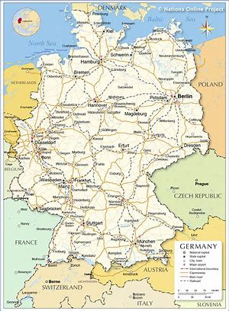
Facts
Germany has a population of 81 million people
Berlin is Germany’s Capital City
Germany is one of the most densely populated countries in the world
Germany entered the EU on January 1st 1958
Germany is the EU’s largest economy
One third of Germany is still covered in forests and woodlands
Germany shares borders with nine countries Denmark, Poland, the Czech
Republic, Austria, Switzerland ,France, Belgium ,Luxembourg and The
Netherlands

Slide 3
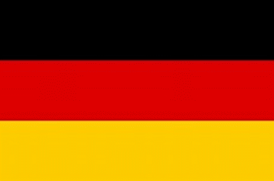
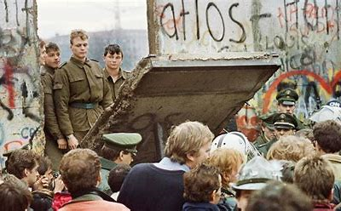
German History
World War 1 begins in 1914 with Germany part of the central powers with Austria
and the ottoman Empire
In 1939 World war two begins and Germany invades Poland
In World War II in Europe ends when the German army surrender to the Allies
In 1949 Germany split into East and West Germany
In 1961 The Berlin wall is built
In 1989 the Berlin wall was torn down
In 1990 Germany is reunified into a single Country

Slide 4
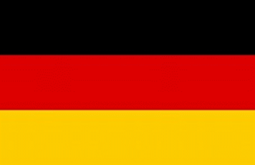
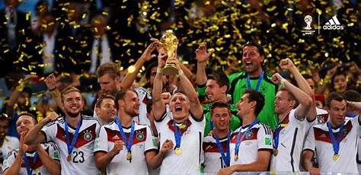
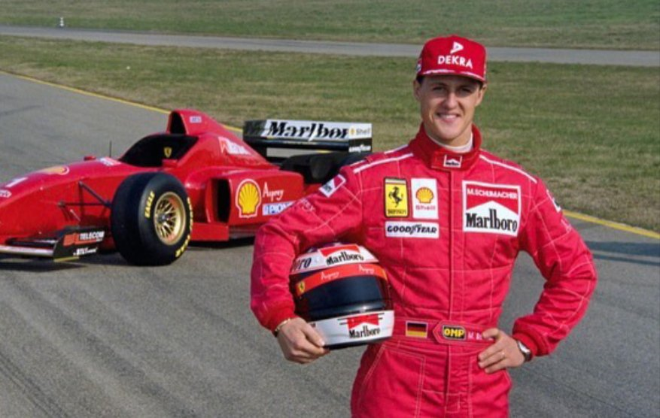
German Sporting History
Germany has 1681 Olympic medals with 547 being gold
Germany has only lost one penalty shootout in a major football tournament
it was in 1976 when west Germany lost 5~3 to Czechoslovakia
Germany has one the FIFA World Cup 4 times
Michael Schumacher until recently was the most successful F1 driver in the world
with seven world titles

Slide 5
German Fun Facts
Smoking is banned in public places but drinking alcohol is still legal
The Christmas tree tradition is from Germany
Toilet paper in Germany has the softness and consistency of paper towels
In Germany there is no punishment if a prisoner attempts to break out of prison
because its basic human instinct to be free
University is free in Germany even to non Germans
Germany has more bridges than Venice
Germany is one of the largest car producers selling almost 6 million cars a year,
with the biggest Brands being BMW, Audi, Mercedes & Volkswagen

Slide 6
