Slide 1
1916 rising
Joseph Gavin

Slide 2
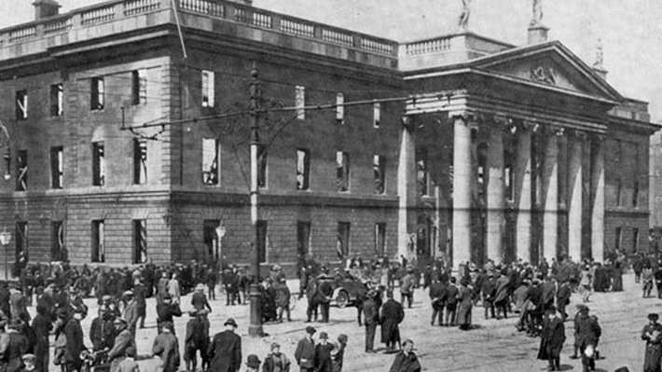
Start of the 1916 rising
The Easter Rising, also known as the Easter Rebellion, was an armed insurrection in Ireland during Easter Week, April 1916. The Rising was launched by Irish republicans to end British rule in Ireland and establish an independent Irish Republic while the United Kingdom was fighting the First World War

Slide 3
1916 Facts
The seven members of Irish Republican Brotherhood Military Council who planned the Rising were Thomas Clarke, Seán McDermott, Patrick Pearse, Eamonn Ceannt, Joseph Plunkett, James Connolly, and Thomas MacDonagh. All were executed after the Rising.
The General Post Office became the main headquarters of the rebellion, with five of the seven members of the Military Council/Provisional Government of the Irish Republic serving there.
After hearing the news that a ship carrying German weaponry was captured, the Military Council decided to carry out the insurrection on Monday, April 24, 1916, in an emergency meeting held on Sunday morning, April 23.
Before his execution, McDermott wrote, "I feel happiness the like of which I have never experienced. I die that the Irish nation might live

Slide 4
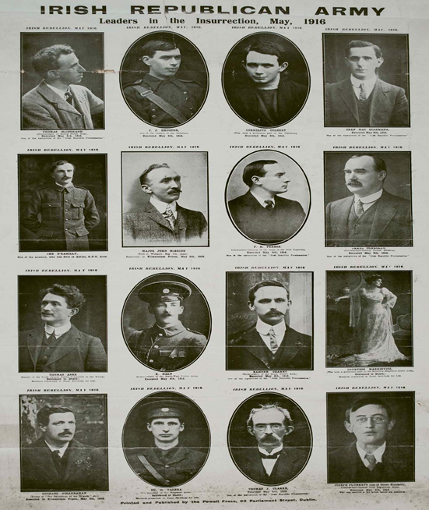
1916 leaders
Éamonn Ceannt.
Thomas James Clarke.
James Connolly
Seán MacDiarmada.
Thomas MacDonagh.
Patrick Pearse.
Joseph Mary Plunkett.
Roger Casement.

Slide 5
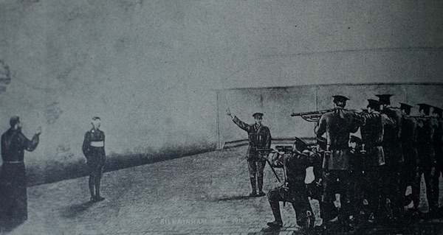
Executed Leaders
Nine were executed for their part in planning or leading the rising.
The nine leaders were
Roger Casement
Con Colbert
Edward Daly
Seán Heuston
Thomas Kent
John MacBride
Michael Mallin
Michael O’Hanrahan
William Pearse

Slide 6
End of the 1916 Rising
On Saturday the 29th of April 1916, Patrick Pearse surrendered to the British commander General Lowe to save the lives of rebels and civilians. The rebels were taken as prisoners to Richmond Barracks. Fifteen of the leaders were executed and many others were sent to prisons, mainly in England or Wales.
The 1916 Rising had failed to get independence for Ireland. However the Rising had made the cause of independence more popular as many Irish people were so outraged by the executions that they also began to call for independence from Britain. Outside of Dublin, the other main place where the Easter Rising took place was in Ashbourne, County Meath.
Dublin city centre was almost completely destroyed after the Easter Rising. There was a total of five hundred people killed during the fighting. Three hundred of the dead were civilians who were not involved in the fighting. There were a total of 2,500 wounded, of which 2,000 were ordinary civilians. Fifteen executions took place after the Rising, and 1,841 suspected rebels were sent to prison in England.

