Slide 1
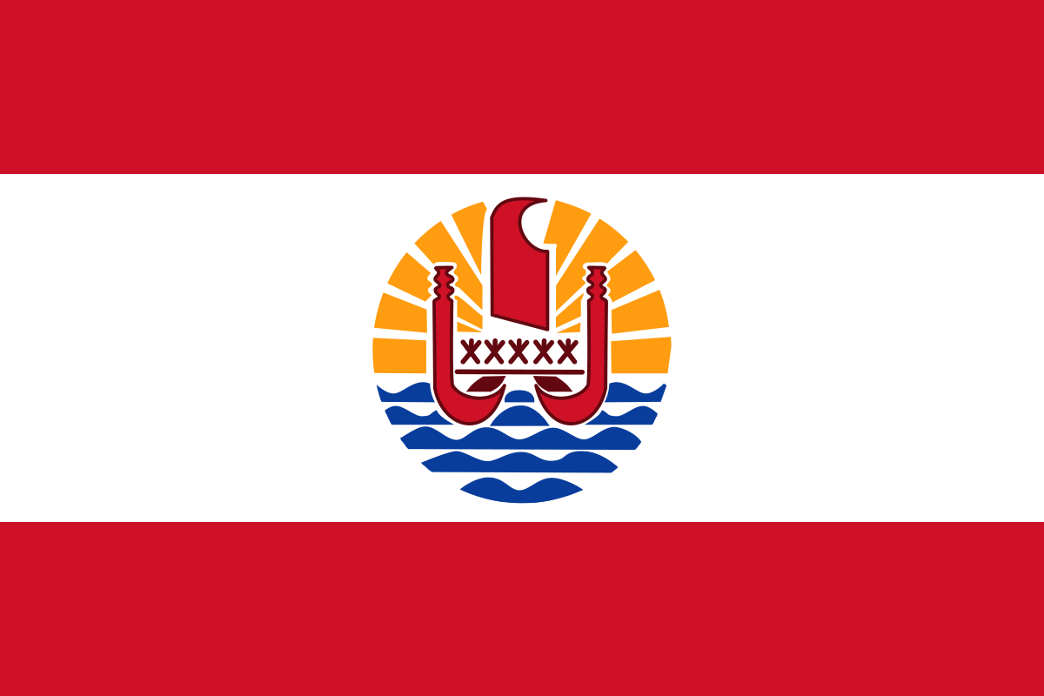
This is my project and the country is French Polynesia

Slide 2
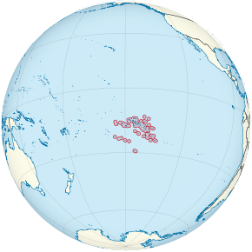
Historical population
1907 | 1911 | 1921 | 1926 | 1931 | 1936 | 1941 | 1946 | 1951 | 1956
30,600 | 31,900 | 31,600 | 35,900 | 40,400 | 44,000 | 51,200 | 58,200 | 63,300 | 76,323
1962 | 1971 | 1977 | 1983 | 1988 | 1996 | 2002 | 2007 | 2012 | 2017
84,551 | 119,168 | 137,382 | 166,753 | 188,814 | 219,521 | 245,516 | 259,596 | 268,270 | 275,918
17°34′S 149°36′W
French Polynesia is in the pacific ocean
And its made up of 118 volcanos and core island
The population is 286,900

Slide 3
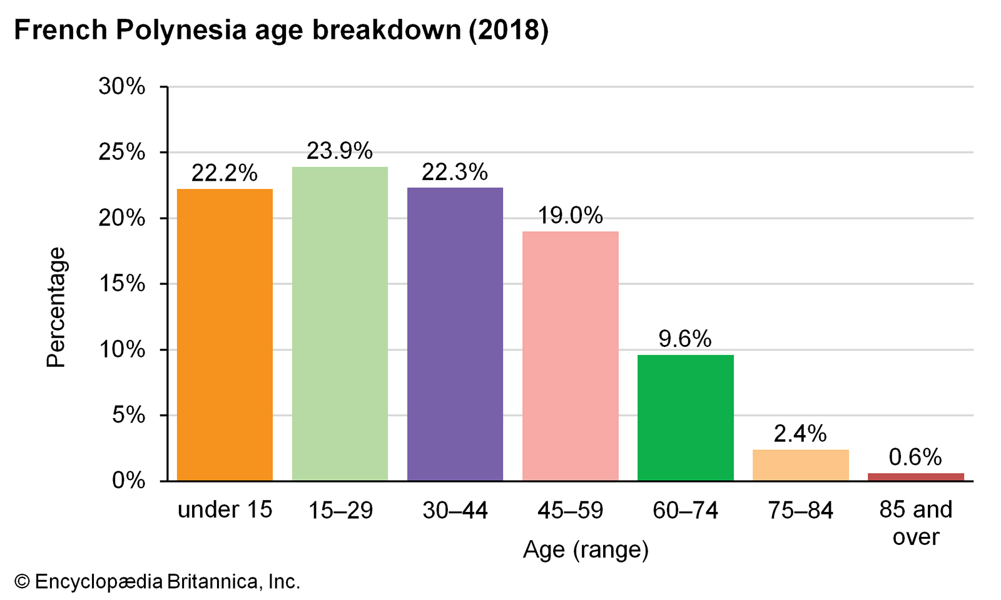
Above shows the age profile for French Polynesia in 2018

Slide 4
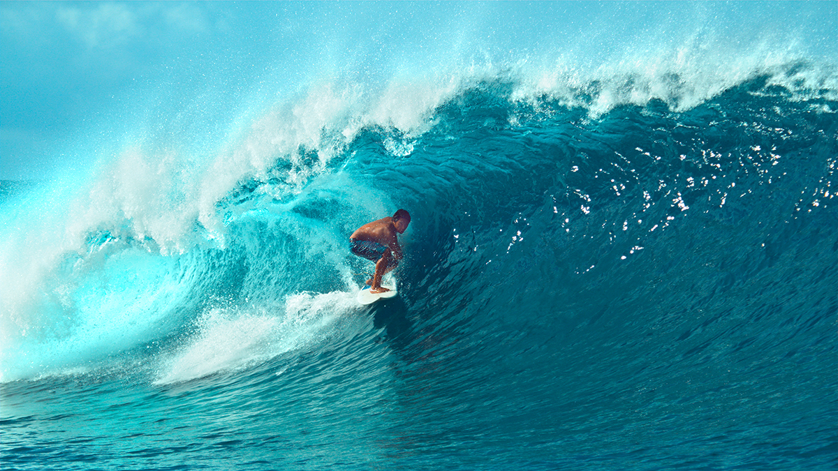
This sport is called surfing and its on there sports that’s famous for them
And how u play is were u get a board and like glide on the water

