Slide 1
World War 1 (The Great War)
Jul 28, 1914 – Nov 11, 1918
By Seán Clarke

Slide 2
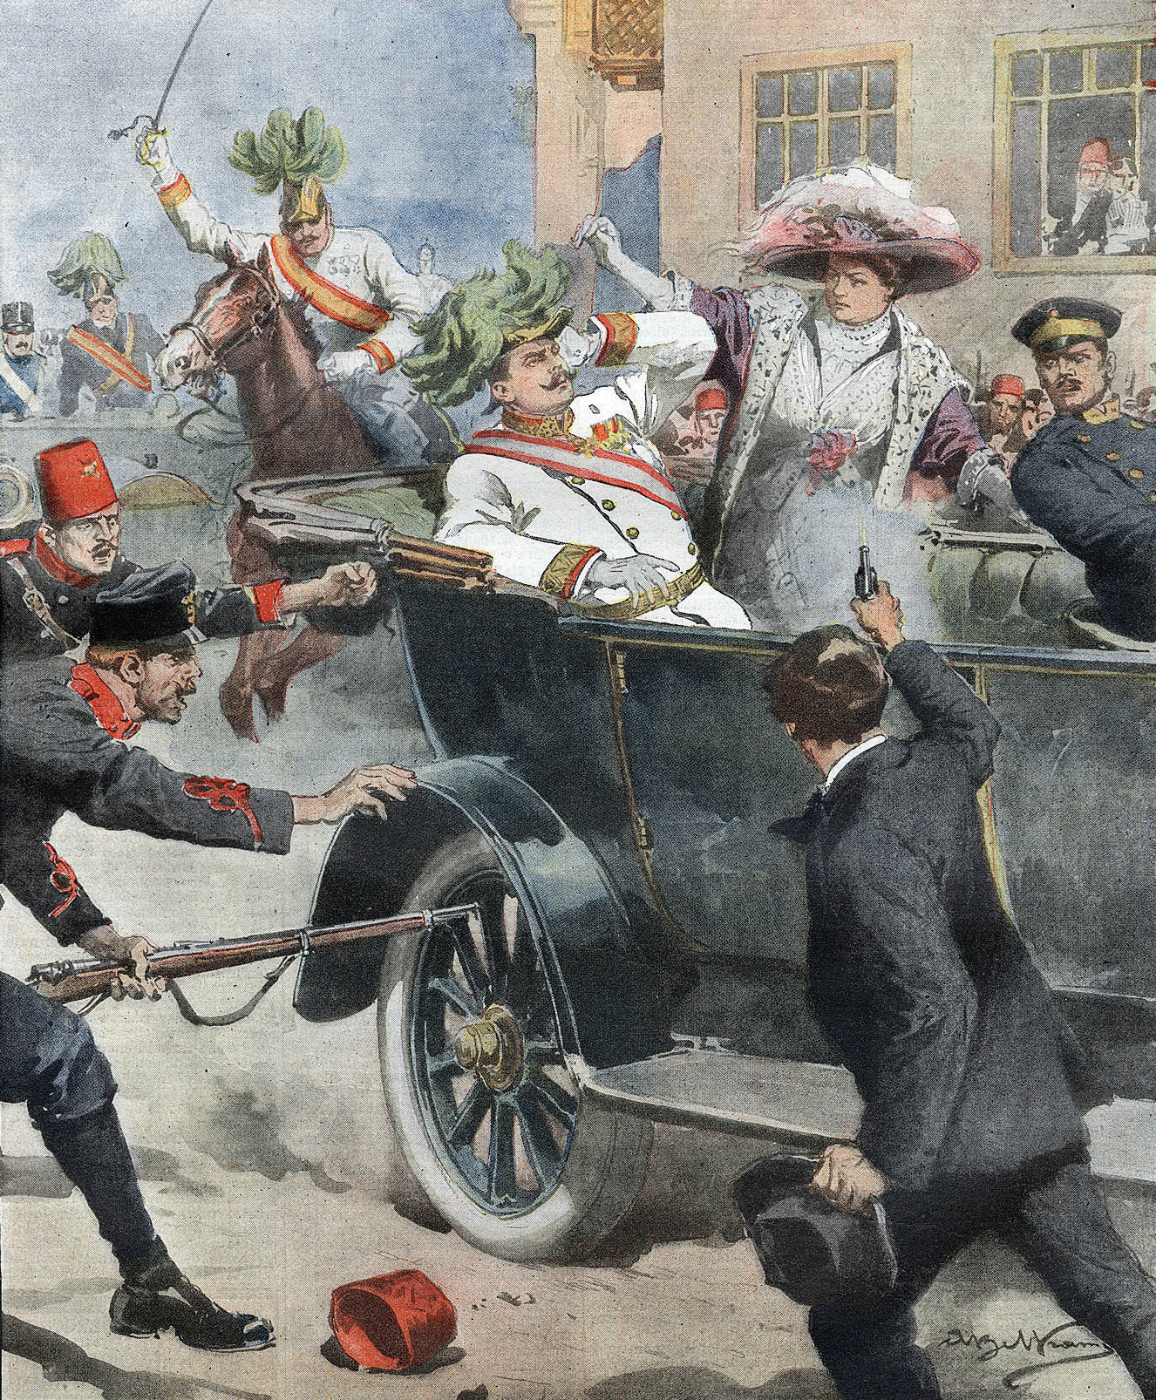
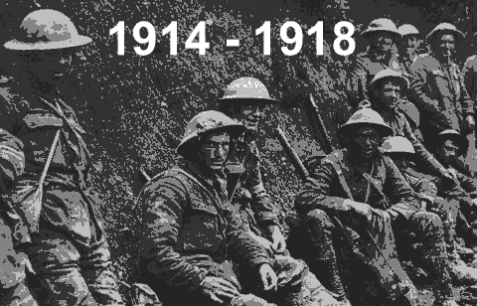
How did it start
World War 1 started after the assassination of Archduke Franz Ferdinand of Austria.
During the conflict, Germany, Austria-Hungary, Bulgaria and the Ottoman Empire (the Central Powers) fought against Great Britain, France, Russia, Italy, Romania, Japan and the United States (the Allied Powers)
By the time the war was over and the Allied Powers claimed victory, more than 16 million people, soldiers and civilians were dead.

Slide 3
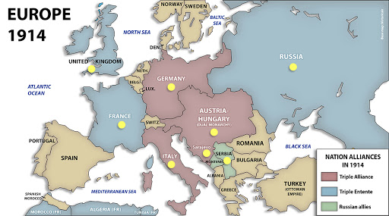
Alliances in World War 1

Slide 4
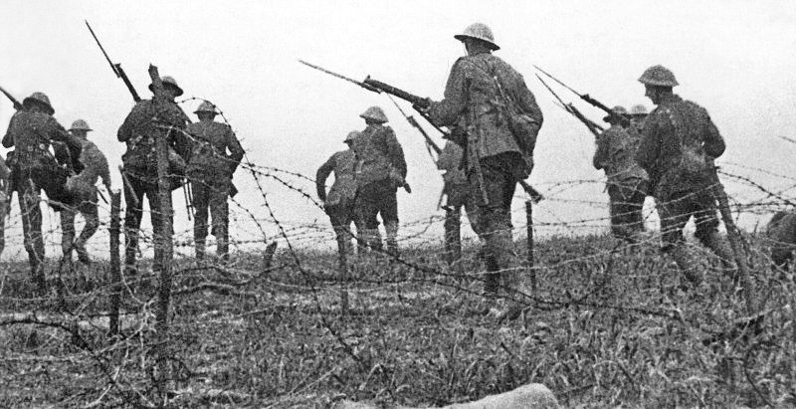
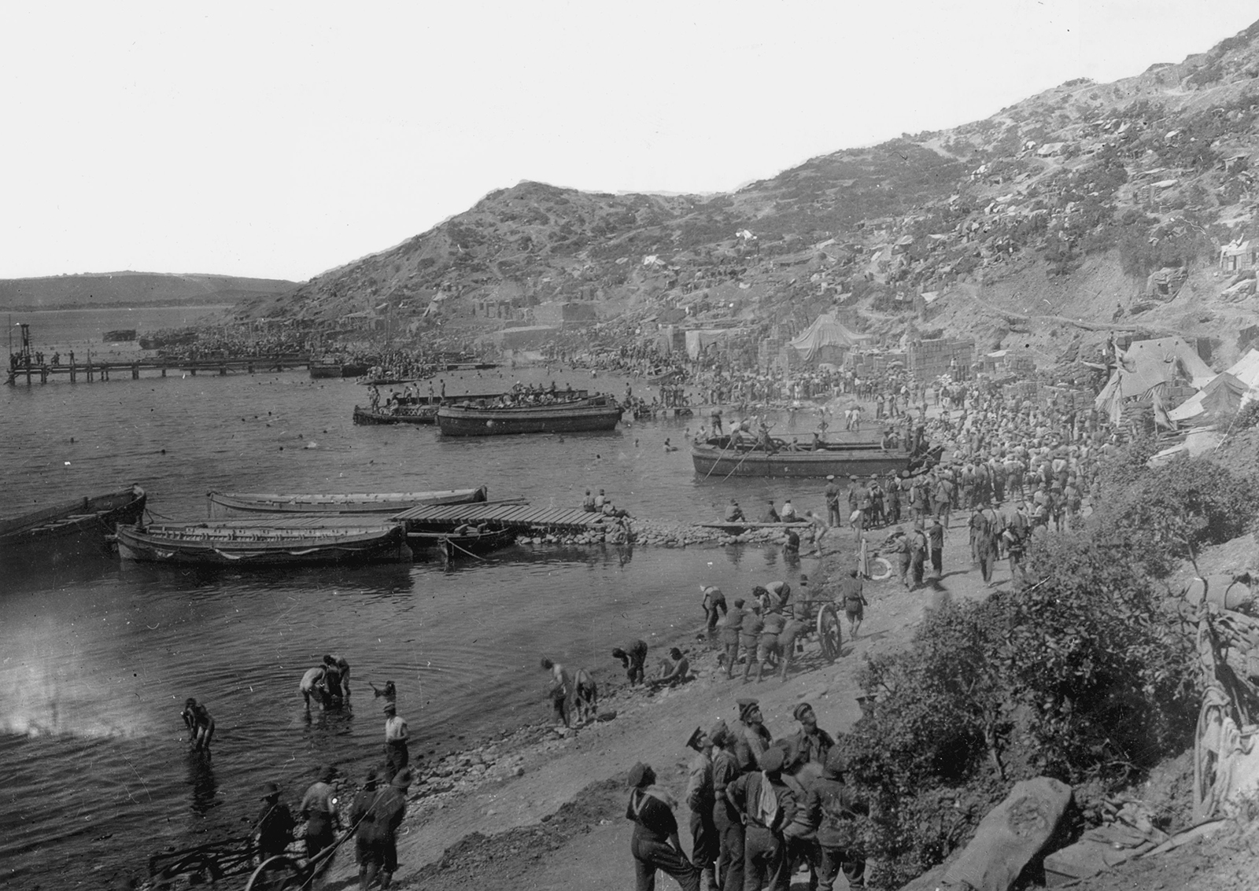
Famous Battles In World War 1
Battle of Marne in north-eastern France was the first major battle of World War 1. The French and English armies defeated the German army.
The Battle of the Somme on the western front was one of the biggest battles in World War 1. It lasted nearly 5 months involving 3 million Allied and German soldiers. 19,000 British soldiers were killed on the first day. By the end more than 3 million soldiers had fought on both sides, and more than 1 million had been killed.
The Gallipoli campaign was a battle intended to allow Allied ships to pass through the Dardanelles, and capture Constantinople (now Istanbul). The battle was unsuccessful and 44,000 Allied soldiers died.

Slide 5
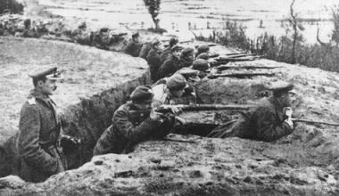
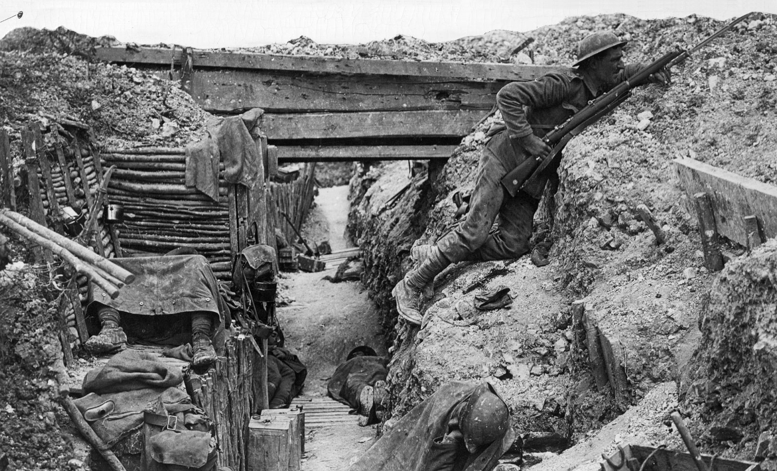
Trench Warfare
By the winter of 1915, the opposing sides had both dug long ditches called trenches which faced each other, in some places just 30m apart. These lines of narrow trenches stretched from the Belgian coast to Switzerland, and were known as the Western Front. Over five million British soldiers spent time living in these muddy, miserable ditches, taking it in turns to be on the Front Line. (The trench closest to the enemy).

Slide 6
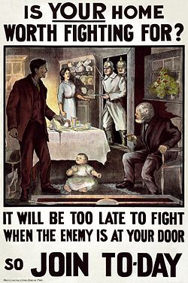
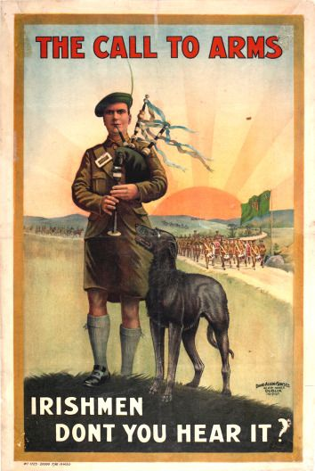
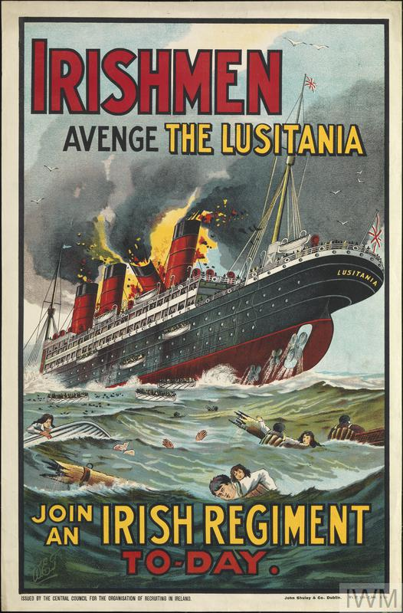
Irish who fought in World War 1
In all, about 210,000 Irishmen served in the British forces during World War One. Since there was no conscription, about 140,000 of these joined during the war as volunteers.
35,000 Irishmen died.
Irish Regiments who had their battalions raised and garrisoned in Ireland, serving with the regular British army in World War 1 included Royal Irish Regiment, Royal Inniskilling Fusiliers, Royal Irish Rifles, Princess Victoria’s, Connaught Rangers, Prince Of Wales’s Leinster Regiment, Royal Dublin Fusiliers and Royal Munster Fusiliers.

Slide 7
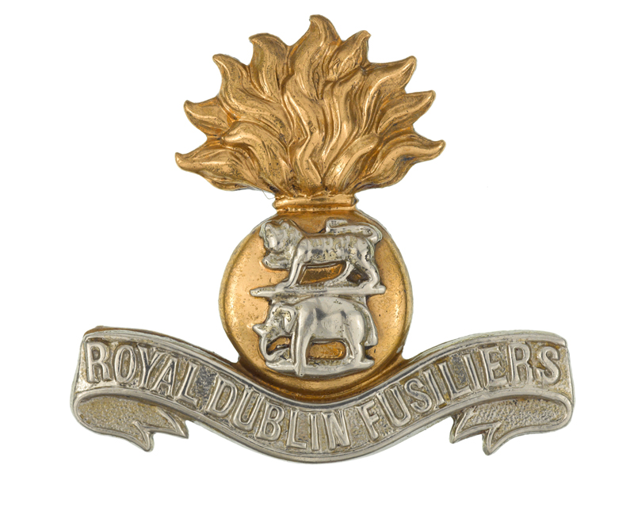
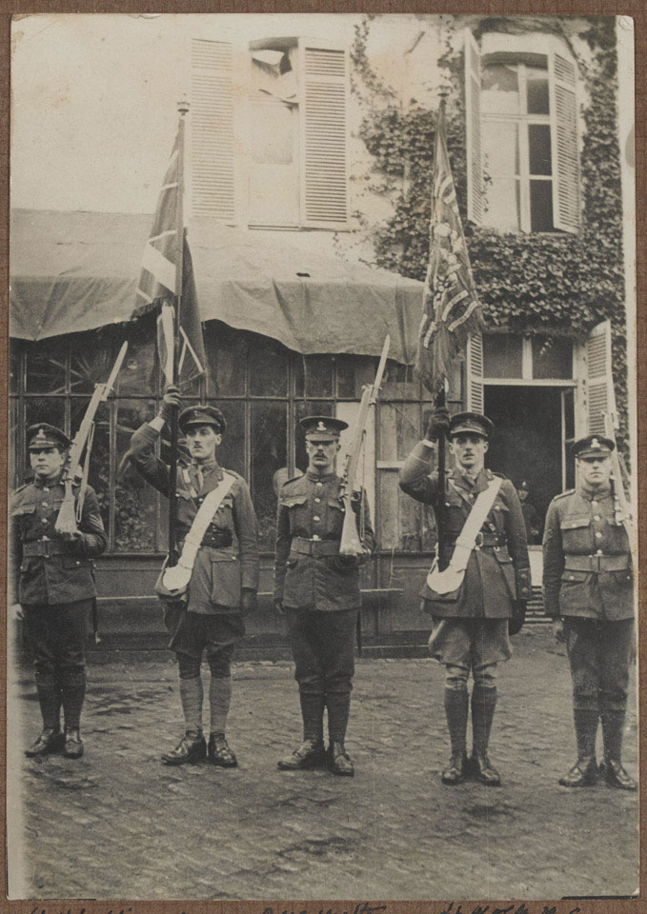
The Royal Dublin Fusiliers
The Royal Dublin Fusiliers was an infantry regiment of the British Army, which recruited in the east of Ireland. Created in 1881 by the amalgamation of two former East India Company regiments, it was disbanded in 1922 on the establishment of the Irish Free State.
The regiment raised six battalions for the First World War. During the conflict, it won three Victoria Crosses and fought in Gallipoli and Palestine as well as on the Western Front.
Back in Dublin, it also became involved in the Easter Rising of 1916. Three of its battalions were sent to engage Irish nationalists.

Slide 8
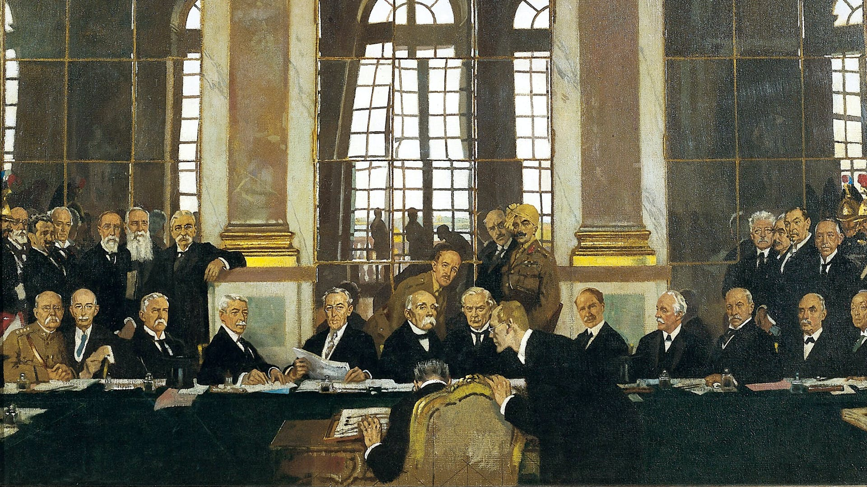
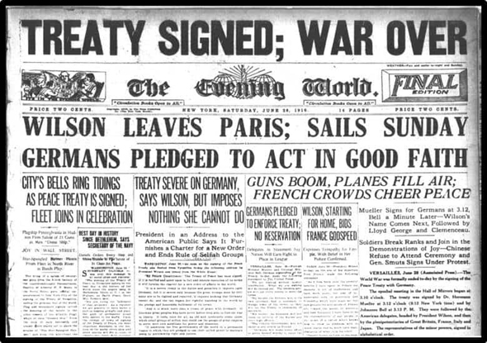
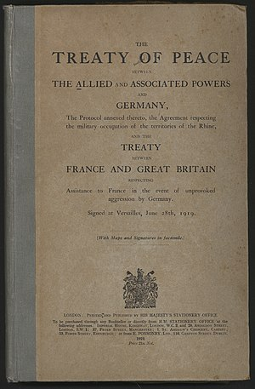
End of World War 1
Germany surrendered on November 11, 1918, and all nations had agreed to stop fighting while the terms of peace were negotiated.
On June 28, 1919, Germany and the Allied Nations (including Britain, France, Italy and Russia) signed the Treaty of Versailles, formally ending the war.
The German government did not participate in the treaty negotiations. Germany had the choice between signing it or facing the occupation of Germany by Allied troops.
The French made the Treaty unfavourable for the Germans so that Germany would not be able to start a new war.
The treaty was later used as a reason for Germany's nationalists and Adolf Hitler to try to get the support of the Germans to get rid of the “Chains of Versailles," which finally led to World War II.

