Slide 1
Spain

Slide 2
Facts
Population: 48 million people live in Spain last recorded 2019
Capital: Madrid, with 3.3 million people in it
Currency: 1 Euro=100 cents, before 2001 Spanish peseta
More than 98 percent can read and write

Slide 3
Facts about Spain
From 711 to 1492 Islamic Moors ruled in Spain. In 1492 Christopher Columbus discovers America and the Spanish rulers start making their empire.
At 48 million Spain has Europe's fifth largest population
It is the EU’s second largest country
Spanish is the worlds second most spoken language

Slide 4
Facts
Spain’s national anthem has no words
More than 150,000 tomatoes are thrown at the tomato battle every year
43 percent of the worlds olive oil production is produced in Spain
From 2008 to 2013 Spain’s national team were named Fifa team of the year

Slide 5
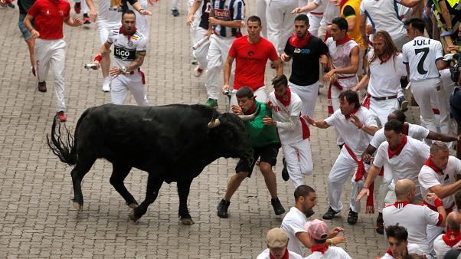
Festival’s
Spain is known for its lively festival’s including running of the bulls and the tomato battle

Slide 6
Restaurants
In Madrid the restaurant botin was awarded the oldest restaurant in the world although other’s claim that other restaurants are older this one was given the Guinness world record for oldest restaurant . Its special dish is suckling pig ( cochinillos asado ) is their dish in Spanish

