Slide 1
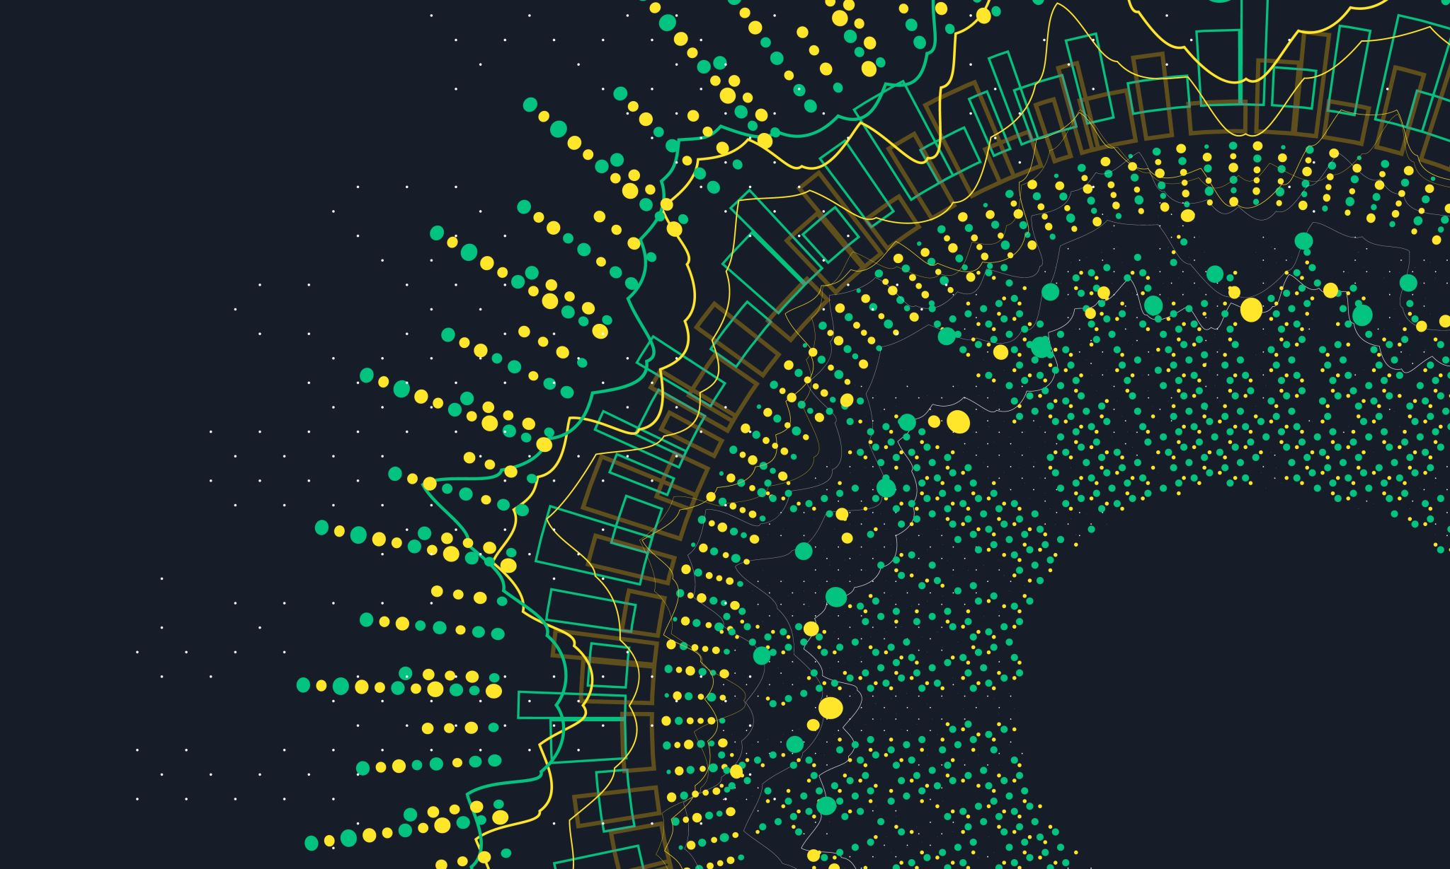
The Great Famine An Gorta Mór
The story of the years of great hunger in Ireland
By James Murphy

Slide 2
Introduction
This is my project on The Great Famine.

Slide 3
What it is
A famine is a widespread scarcity of food caused sometimes by crop failure. This phenomenon is usually accompanied or followed by regional malnutrition, starvation, epidemic, and increased mortality.

Slide 4
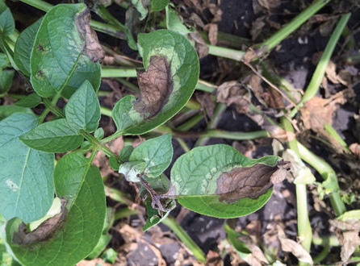
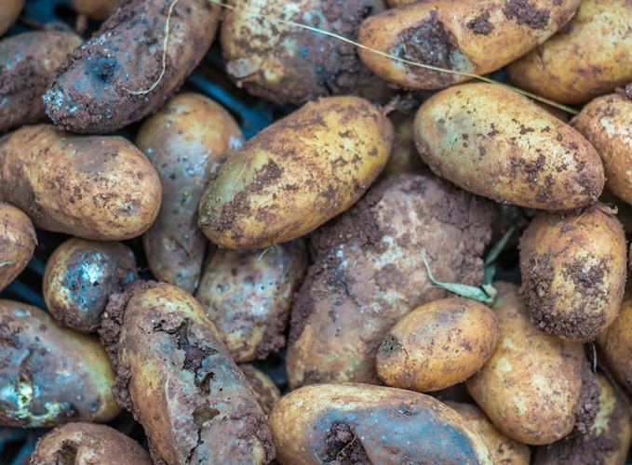
How it started in Ireland
The Famine began quite mysteriously in 1845 as leaves on potato plants suddenly turned black and curled, then rotted, seemingly the result of a fog that had wafted across the fields of Ireland.

Slide 5
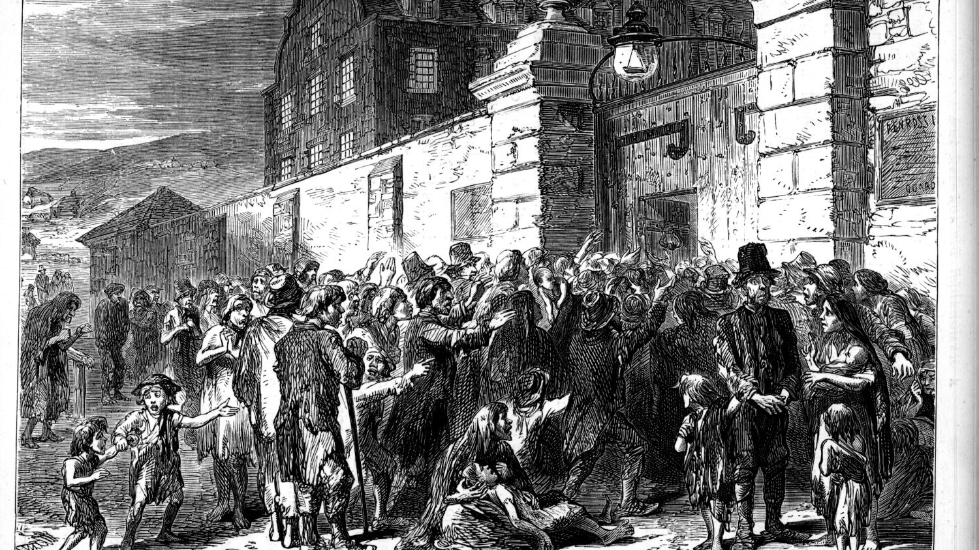
How it affected Ireland
The Famine decimated Irelands population which stood at about 8.5 million on the eve of the Famine. It is estimated that Famine caused about 1 million deaths between 1845 and 1851 either from starvation or hunger related disease. A further 1 million Irish people emigrated.

Slide 6
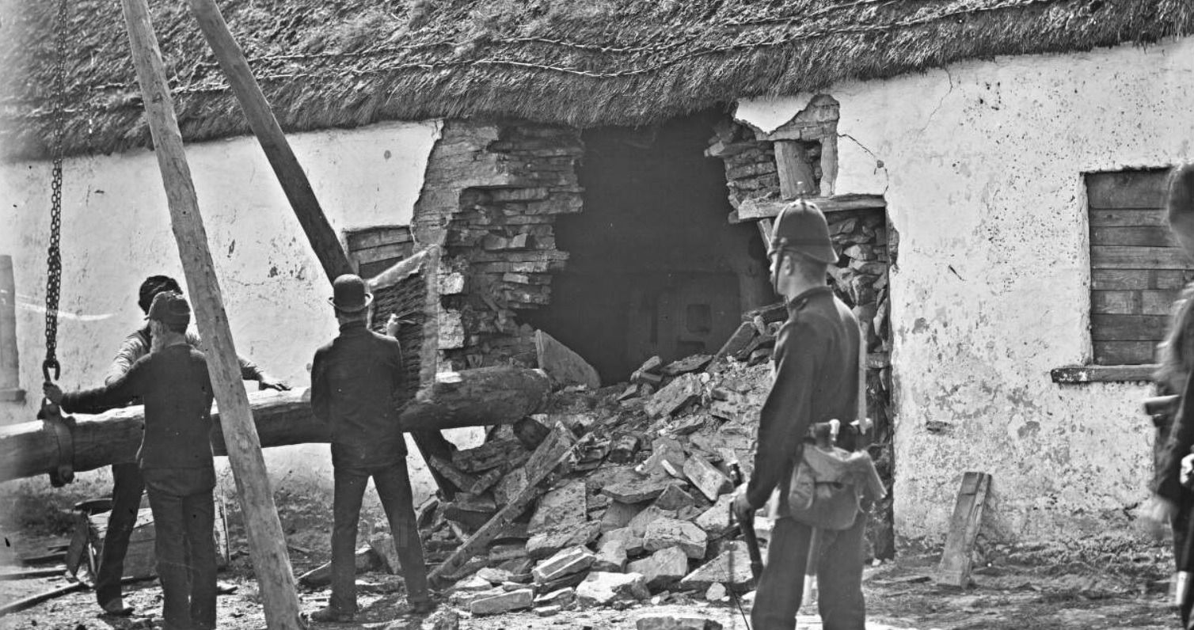
Political structure in Ireland in 1840s
Ireland was governed by Great Britain during this time. Most poor farmers and agricultural labourers lives at a subsistence level and had little to no money to buy food, which was widely available for purchase in Ireland throughout the famine years.
They did however have to continue to pay rents either in cash or in kind, to landlords. Failure to do this during the famine saw many thousands being evicted, greatly worsening the death toll.
The response of the British government was also unsatisfactory. Their decision to drastically cut relief measures in mid 1847, half way through the famine, certainly contributed greatly to the mass death that followed.

Slide 7
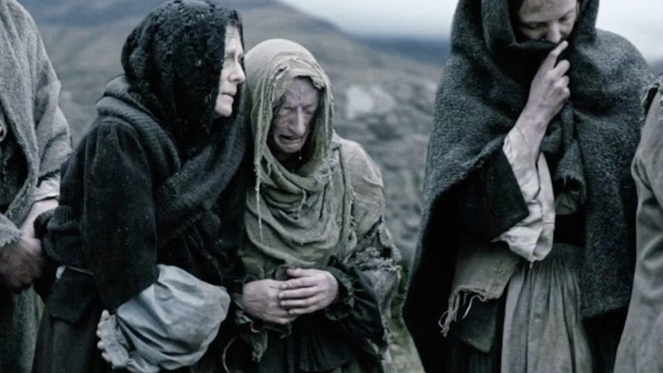
Black 47
1847 known as black 47 in folk memory, marked the worst point of the Famine. The potato crop did not fail that year, but most potato farmers had either not shown seeds in expectation that the potato crop would fail again, did not have any more seeds or had been evicted for failure to pay rent. The result was that hardly any potatoes were harvested for the second year in a row.
Large bands of hungry people began to be noticed wandering the countryside and towns, begging for food. Many flocked to the workhouses where the destitute were granted food and shelter in exchange for work but due to insanitary conditions, many died there….

Slide 8
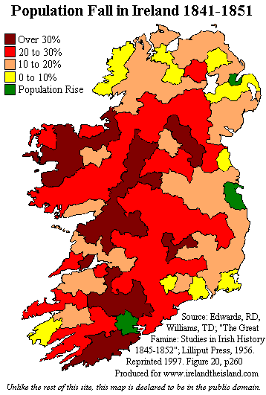
Impact of Famine
It has been calculated that at least 1 million people, or about 12 – 15 % of the population died, mostly from disease, during the famine, the dead being overwhelmingly from the rural poor. Connaught and Munster were the worst affected provinces followed Ulster and the Leinster, but the latter still saw well over 100,000 deaths
Cities such as Dublin, Belfast and Cork saw a rise in population as the destitute flocked there in the hope of aid.
Skibbereen in West Cork, one of the worst affected areas, became the site of mass graves, holding up to 10,000 bodies.

Slide 9
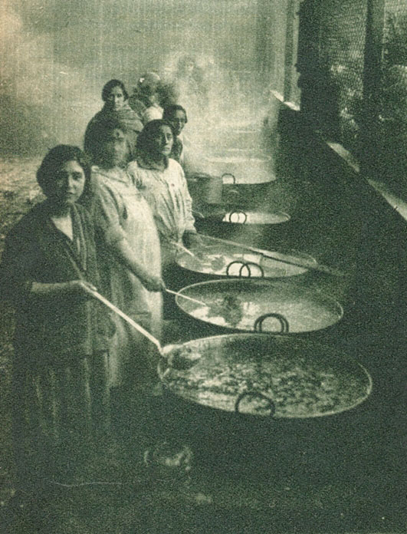
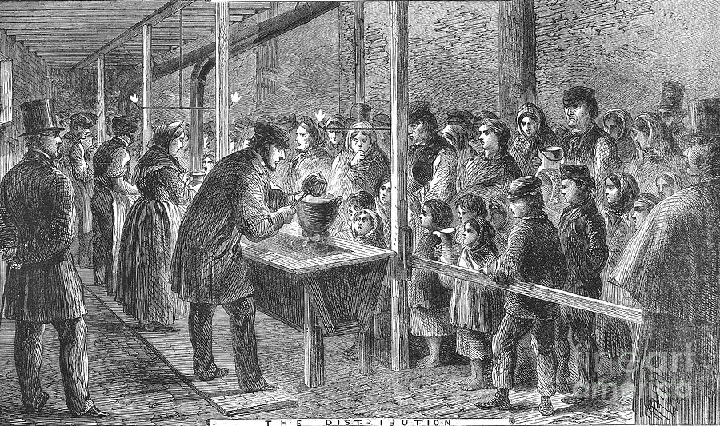
Soup kitchens
In January 1847, the government set up free soup kitchens; which were inexpensive and relatively successful at feeding the poor. But, worried that the poor who were attending the soup kitchens by mid 1847, would become dependent on the Government, they discontinued the soup kitchens at the height of the famine in August 1847.

Slide 10
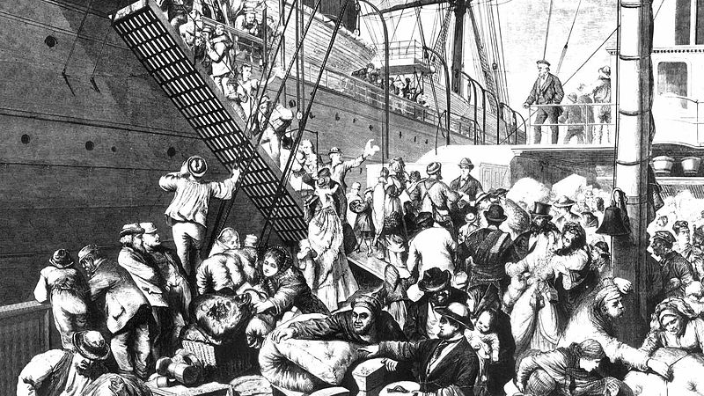
Where did people emigrate to during the famine
Large numbers of Irish people emigrated to countries such as, England, America, Canada and Australia because of the famine. From 1845 – 1850 about one and a half million people left Ireland. It also believed that there would be over 10 million people in Ireland today if it was not for the famine!

Slide 11
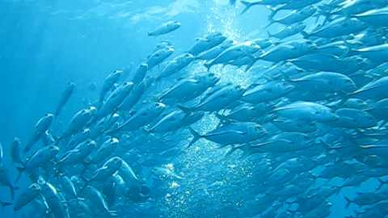
So why did people not try to fish during the famine
The question is often asked, why didn’t the Irish eat more fish during the Famine ? A lot of energy is required to work as a fisherman. Because people were starving they did not have the energy that would be required to go fishing, haul up nets and drag boats ashore. Also many people sold their belongings in order to survive including their boats.
The fishing industry was very undeveloped at this time and a lot of boats were too small for deep sea fishing

Slide 12
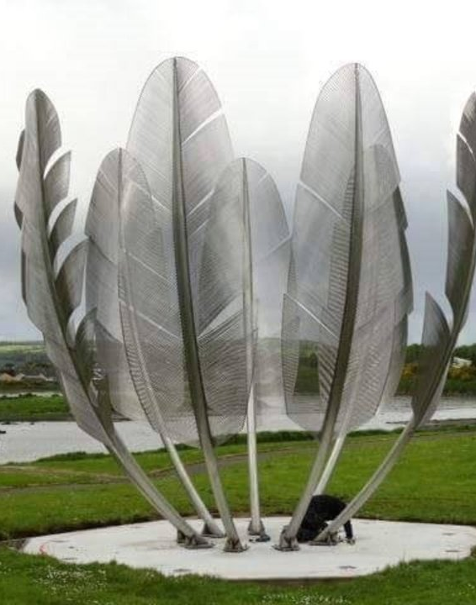
Choctaw and Ireland history
The Choctaw nation is a native American tribe occupying portions of Southeastern Oklahoma in USA.
Both the Choctaw nation and Ireland were, in effect, colonized by outside powers. Their relationship began in 1847 when the Choctaws took up a donation and collected over $5000(in today’s money), to support the Irish during the potato Famine.
The Choctaw’s donation was sent to the town of Midleton in County Cork. In 1995 President Mary Robinson visited the Choctaw nation to thank them for their aid. In 2017 a sculpture commemorating their gift known as “Kindred Spirits” was dedicated in a beautiful park in Midleton
In 2020 when the COVID-19 19 pandemic struck the death toll was particularly high in the Navajo nation and the Hopi Reservation. The Irish stating that they were paying it forward, made a sizeable donation to aid and assist the Navajo and Hopi.

