Slide 1
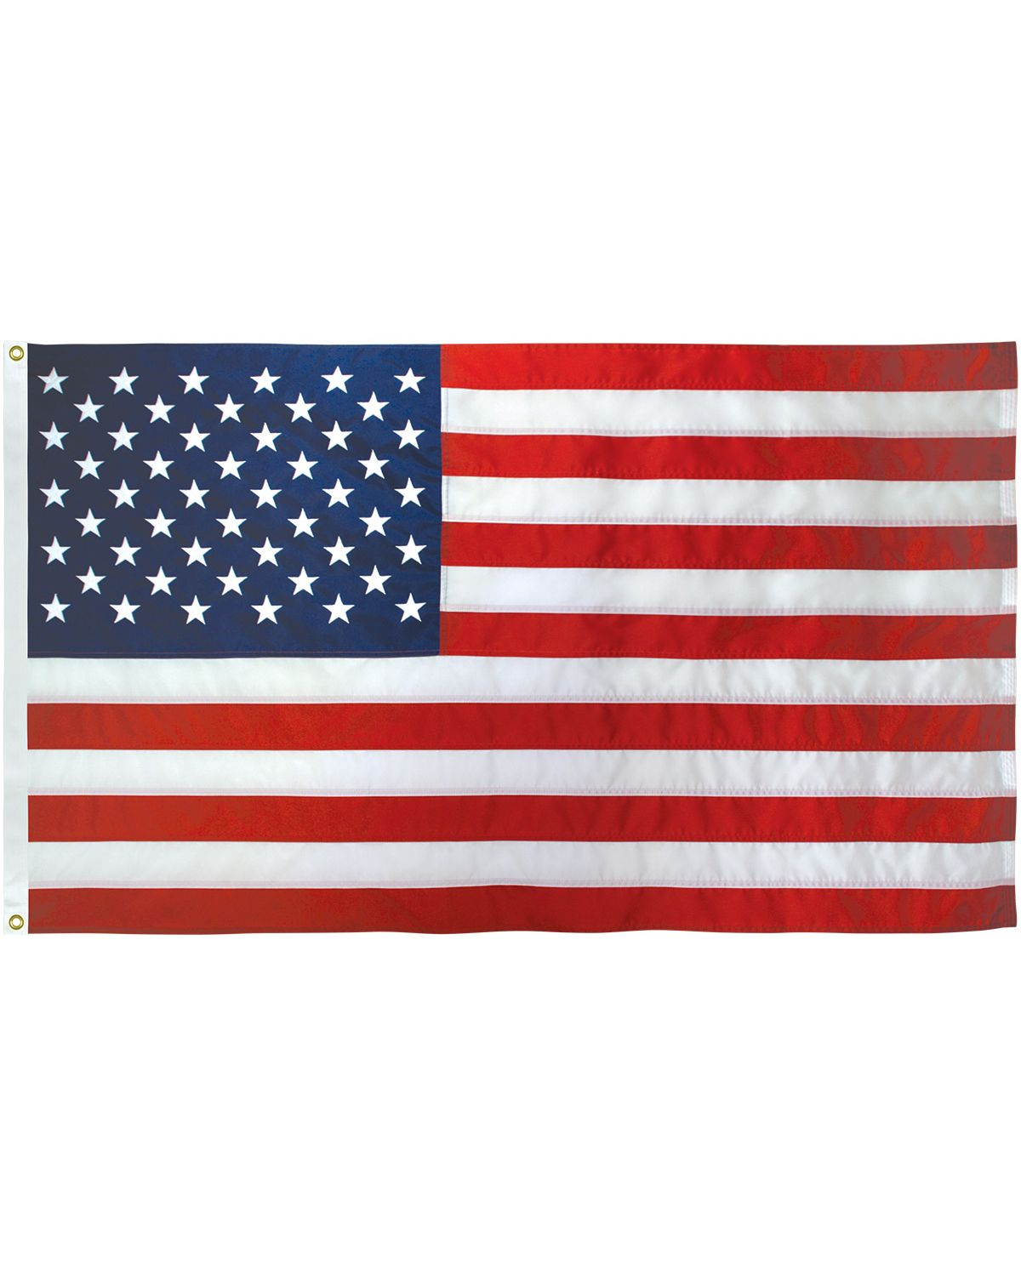
U.S.A. Project
LEONS PROJECT - October 2019

Slide 2
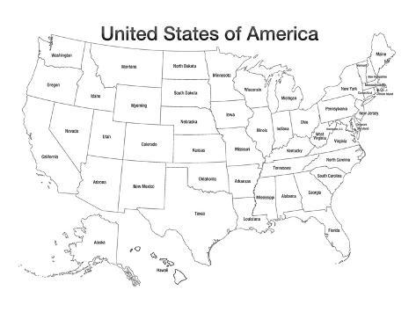
Notes:
Map of 50 states, hawaii is an island off the west coast and alaska is next to Canada. They were the 49th and 50th states to join the US.

Slide 3
Geographical Facts
Population | 325 million (2017) 327 million estimate
Capital | Washington DC
Longest River | Missouri (4088km)
Largest Mountain | Denali (Alaska)
Number of States | 50

Slide 4
Geographical Facts
States | 50
Largest State | Alaska
Smallest State | Rhode Island
Largest Mountain | Denali (Alaska)
49th and 50th States | Alaska and Hawaii

Slide 5
Historical Facts
First President | George Washington
Current President | Donald Trump
Date of Independence | 4th July 1776
Flag | Stars and Stripes
National Anthem | Star Spangled Banner

Slide 6
Other Facts
National Animal | Bald Eagle
National Sports | Baseball,Basketball,American Football, Ice Hockey
Famous Multinationals | eBay, Amazon, Microsoft, Google, Twitter,Facebook Apple and Dell
Largest City | New York

Slide 7
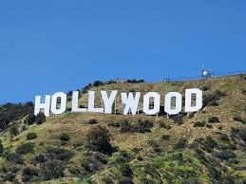
Other Facts
Currency | Dollar
Important Landmarks | Hollywood Sign, Statue of Liberty, Grand Canyon, Yellowstone Park, White House
World Famous Celebritys | Bill Gates, Oprah Winfey, Barack Obama, Donald Trump, Brad Pitt, Stephen Speilberg

Slide 8
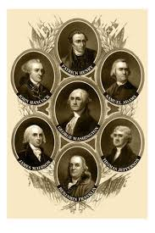
Founding Fathers
The Founding Fathers United the
13 Colonies to start the War of Independence
Against the British .
Notes:
The 5 founding Fathers were said to have been 1. John Adams, 2. Thomas Jefferson High, 3. Benjamin Franklin, 4. Roger Sherman and 5. Robert Livingston many schools and collages in america are calloed after one of them.

Slide 9
America at War
America has been involved in a lot of military action over the centuries and have one of the largest military in the world.
Nowadays they wear a Combat Uniform
There are many divisions in the army eg Navy Seals, Special Forces,Marines, Air Force and Ground Force
The head of the Army is the sitting US president.
They have many war ships including USS George Washington, US Greenbay,and USS Virginia

Slide 10
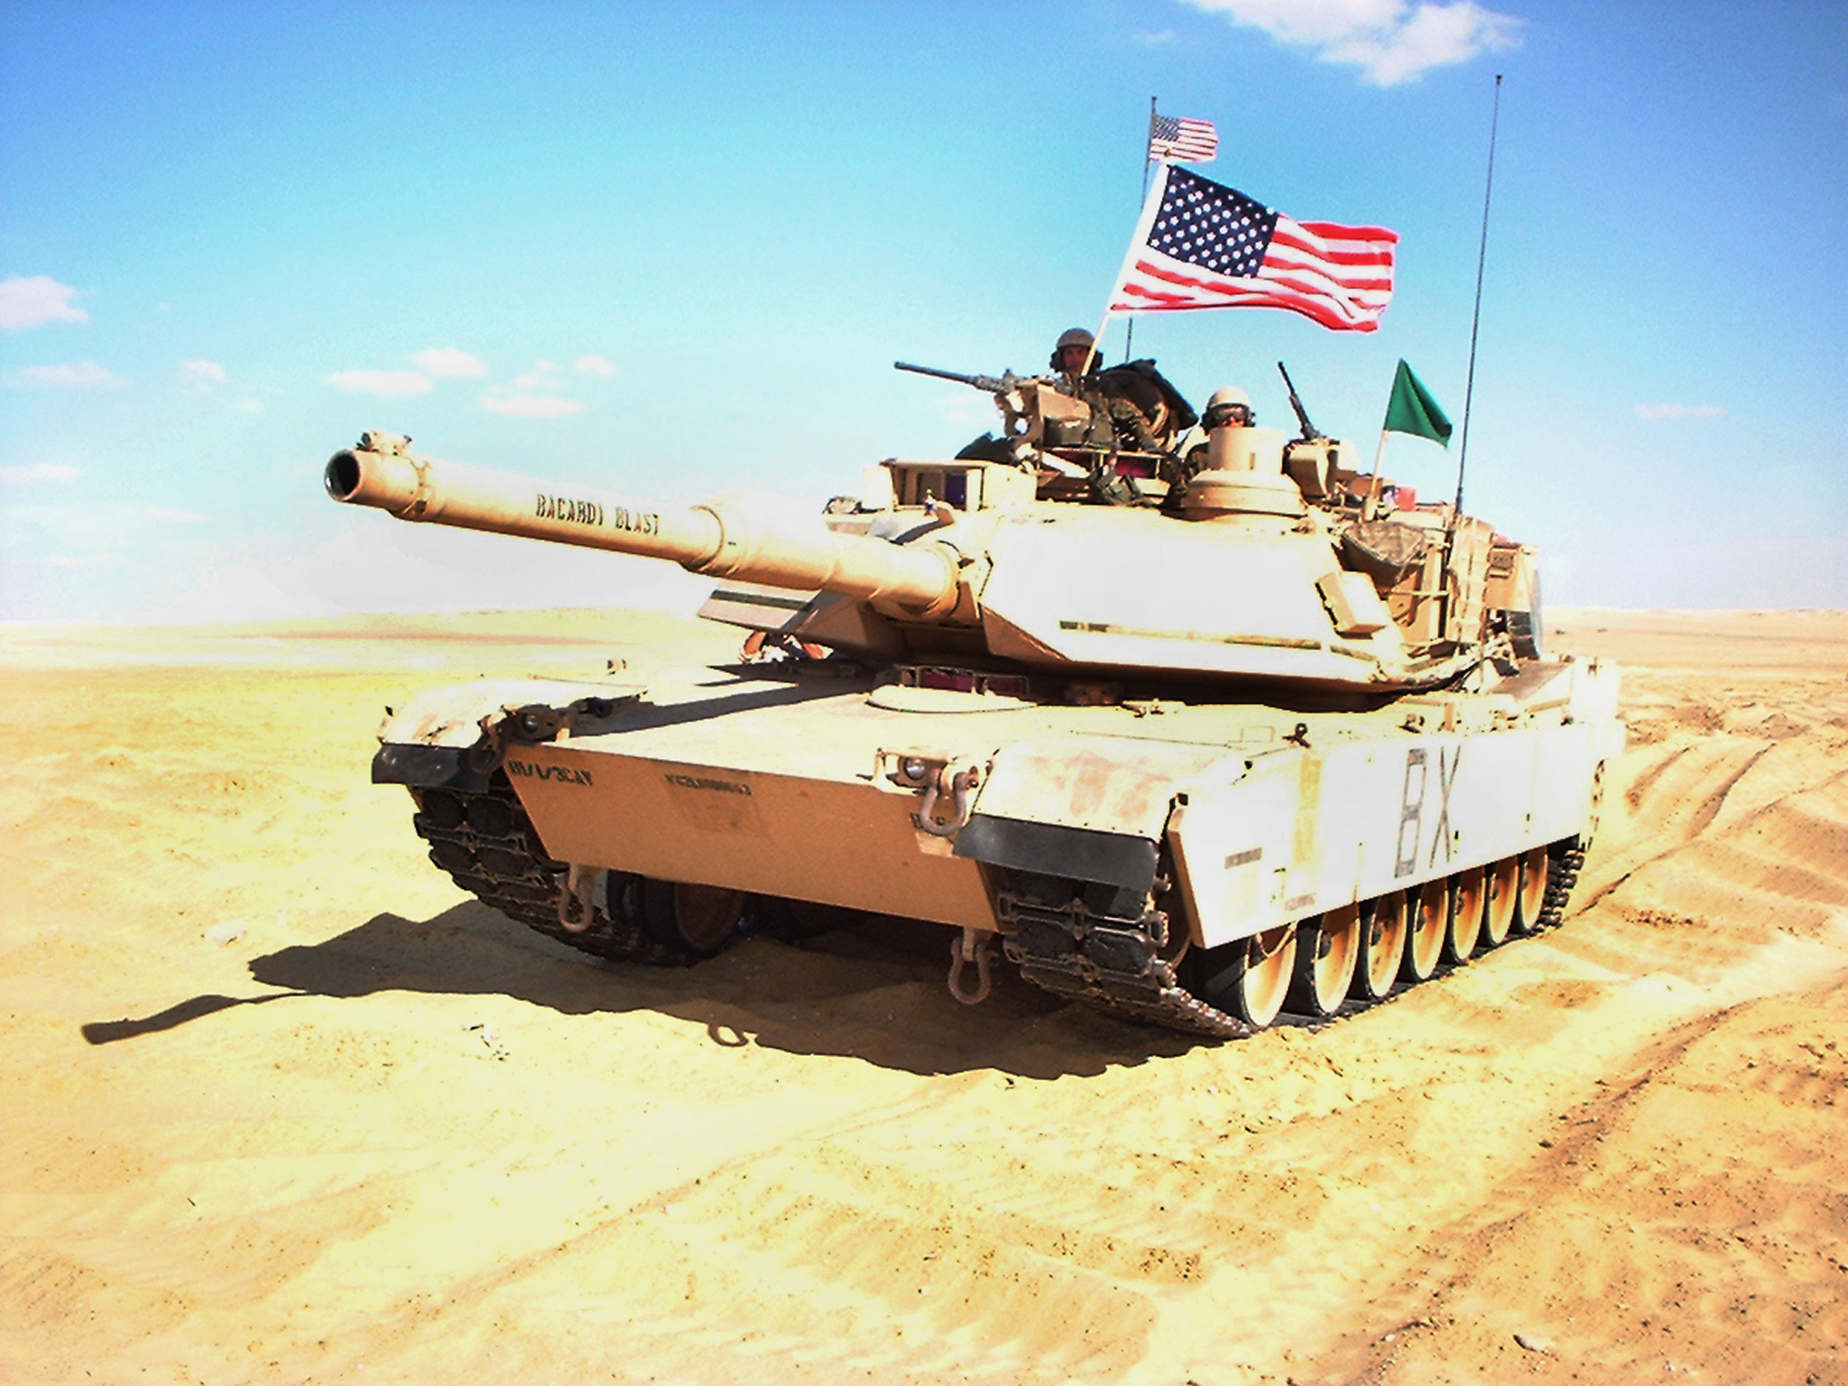
Wars America has been in
WW1 and WW2 | The Korean War
The Bosnian War | The Kosovo War
The Afghanistan War ( post 9/11) | Gulf War 1990-1991 and ongoing interventions in Iraq and Syria

Slide 11
Things I am ‘thankful to America for’
Then modern Culture – Movies and Social Networking
Food – Pizza, Fries and Chicken Wings, McDonalds, Burger King
Lots of interesting War Stories

