Slide 1

World War 1
Josh Elworthy

Slide 2
Archduke Franz Ferdinand
The Thing that caused World War 1 to happen was a man called Archduke Franz Ferdinand.
He started it by shooting Austro Hungarian Empire along with his wife Sophie.
Austria-Hungary blamed the Serbian government.
Which lead to World War 1

Slide 3
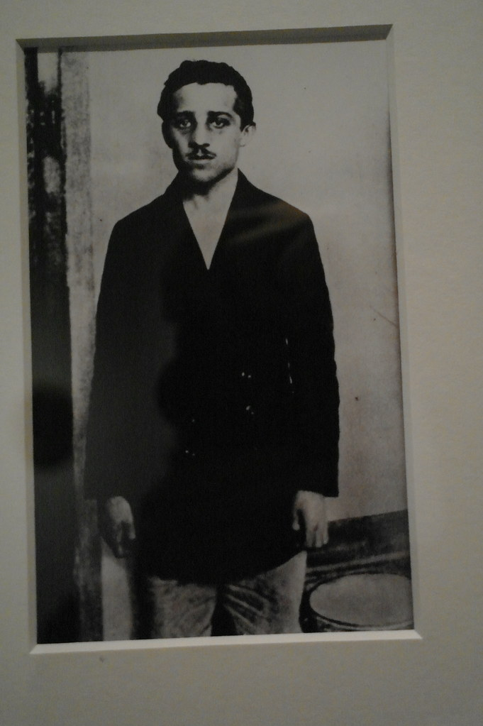
Archduke Franz Ferdinand
This Photo by Unknown Author is licensed under CC BY-SA

Slide 4
A another main factor why World War 1 started was disagreements over Africa And Asia.
The countries that were involved in World War 1 are Germany, Austria-Hungary ,Ottoman Empire and Bulgaria against the allies Great Britain, France, Russia, Italy, Romania, Japan and the United States.

Slide 5
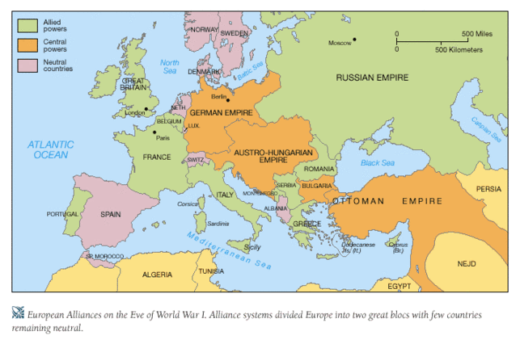
Map of countries in World War 1
This Photo by Unknown Author is licensed under CC BY-SA-NC

Slide 6
1914
World War 1 started on July 28 1914.
The Austrians blamed Serbia government for it and declared war on Serbia.
On August Russia declared war on Austria because there ally was Serbia.
Then Germany declared war on Russia as Austria was there ally. Then France been an ally with Russia declared war with Germany.
But when Germany invaded Belgium England declared war on Germany
Most of the countries thought World War 1 was going to be over in a couple of months.

Slide 7
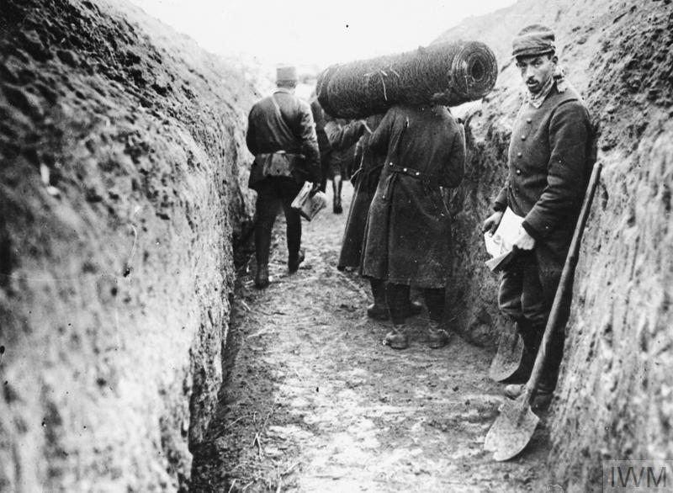
In the trenches
Along the western front soldiers dug deep trenches/a massive hole in the ground to protect themselves from enemy fire.
The land in the middle was called no man’s land also in no mans land there is barbed wire but they were not meet by barb wire they were meet by machine gun fire .
This Photo by Unknown Author is licensed under CC BY-SA

Slide 8
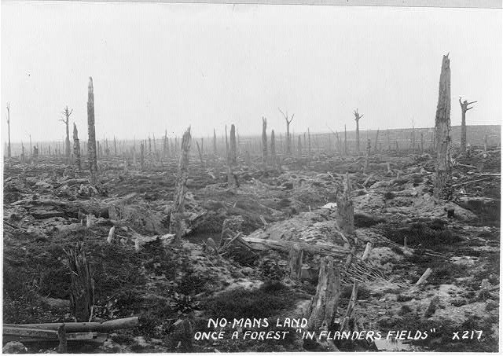
This Photo by Unknown Author is licensed under CC BY-SA-NC

Slide 9
New technology
World War 1 had loads of new technology including the first use of aeroplanes which were used for aerial combat and bombing.
Germans also used U-boats which attacked any military or civilian in enemy waters.
The British had their own thing tanks to try and break the first line on the western front also mines and grenades were widely used by both teams.
World War 1 also seen chemical weapons used by both sides which contained chlorine mustard and phosgene gas.

Slide 10
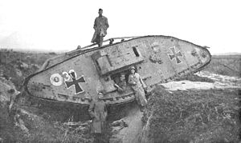
Tanks in World War 1
This Photo by Unknown Author is licensed under CC BY-SA

Slide 11
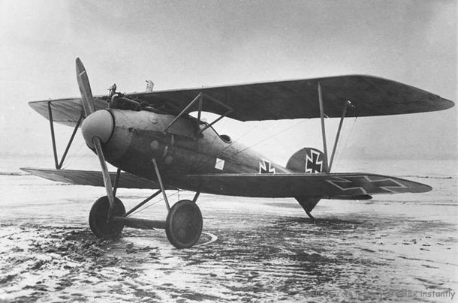
Aeroplane
This Photo by Unknown Author is licensed under CC BY-SA

Slide 12
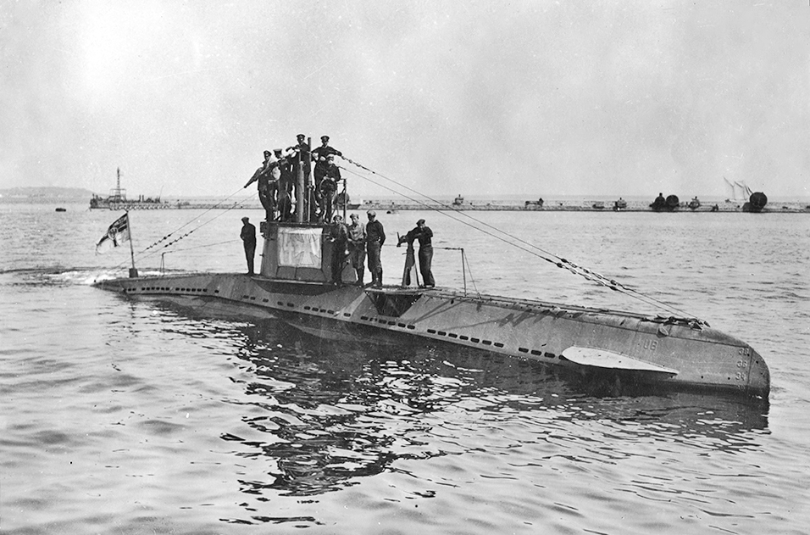
U-boats
This Photo by Unknown Author is licensed under CC BY-SA

Slide 13
1915
In 1915 January 19 Germany raid England east coast with German Zeppelin which hit Yarmouth and King’s Lynn causing 4 deaths.
On the 4th February Germans decide to hit any ships going or coming from England.
Russia suffers a lot of men injured in the second battle of Masurian Lakes.
11th march first ship to be sunk by German U-boats 104 people are lost at sea including 1 American.
Italy joins the war on 23 may with a promise with England and France to get some land

Slide 14
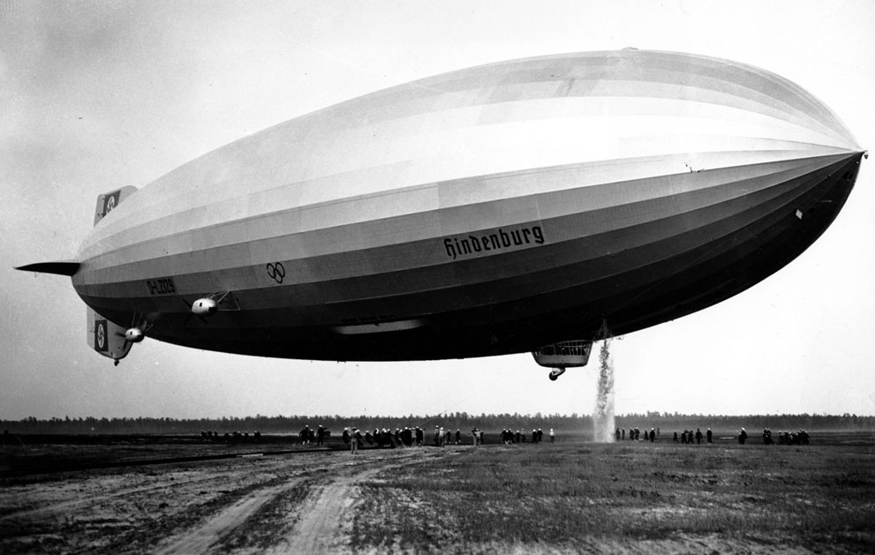
German Zeppelin
This Photo by Unknown Author is licensed under CC BY-NC-ND

Slide 15
1916
Germans using flamethrowers and Strom Troops for the first time in Verdun which will be the bloodiest battle of the war.
In a attempt to knock Italy out of the war in one go Austro-Hungarian forces begin the Trentino attack after loads of Italians troops are killed 147 000 men loss.
In August Romania joins the war with the allies.

Slide 16
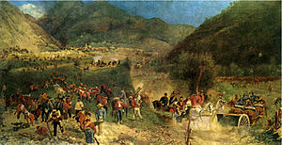
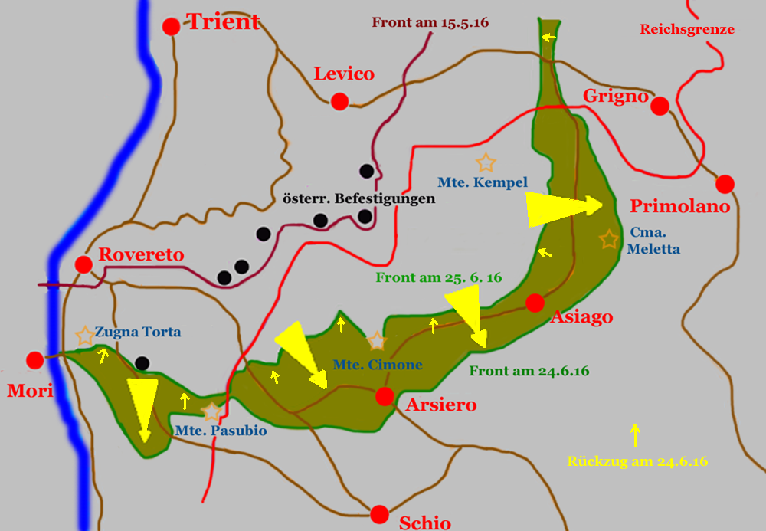
The battle of Trentino
This Photo by Unknown Author is licensed under CC BY-SA
This Photo by Unknown Author is licensed under CC BY-SA

Slide 17
Battle of Somme
July 1 the start of the battle of Somme. In one day England men are seriously injured or killed. Despite huge loses Field Marshal Douglas Haig orders the battle must continue.
Tanks are introduced for the first time on Somme by the British they are used in such small numbers that their impact is not great.
Battle of Somme endes. With about 1.5 million casualties it will be remembered as one of the bloodiest military attacks in history

Slide 18
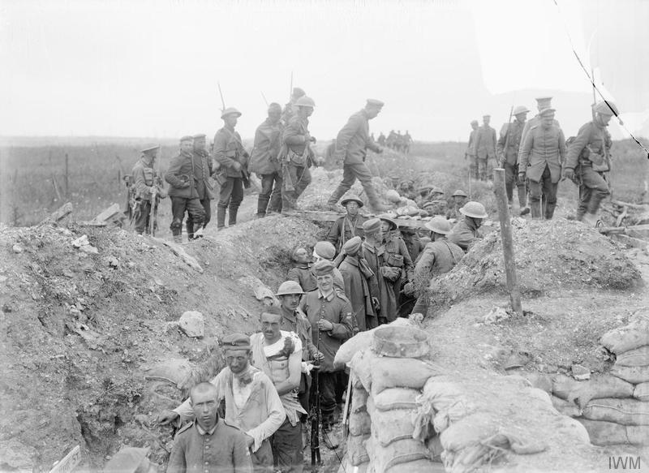
Battle of Somme
This Photo by Unknown Author is licensed under CC BY-SA

Slide 19
1917
The British get a secret message that Mexican will attack America which forces America to join the war.
Germany resume the bombing with U-boats. Greece enters the war on the allies side.
Battle of Cambrai Begins with England mass tank attack catches Germany off guard.

Slide 20
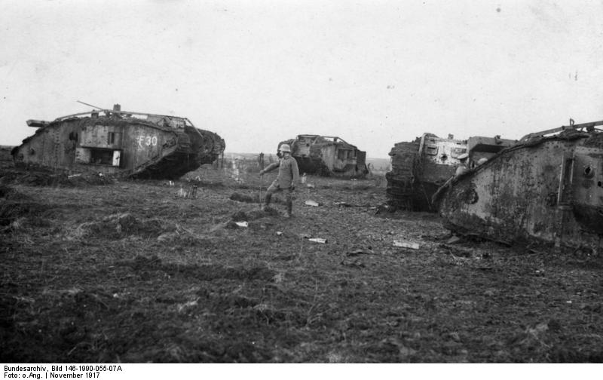
This Photo by Unknown Author is licensed under CC BY-SA

Slide 21
The end of the war
Russia leaves the war on 3 march 1918. Since Russia leaves the war Germany sends most of their men to the Battle of Somme.
The launch the spring offensive their last chance to beat the allies.
On the 4th October Germany ask the Allies for a treaty. Then Austro-Hungarin ask for a treaty.

Slide 22
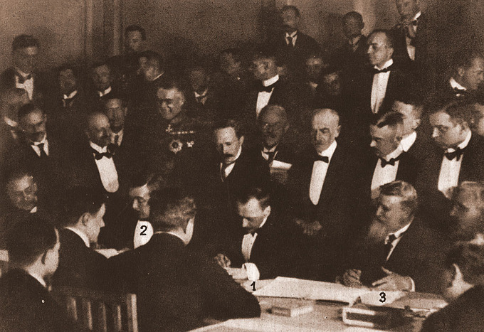
Germany treaty with Allies
This Photo by Unknown Author is licensed under CC BY-SA

Slide 23
Consequences of world war 1
When World War 1 ended there were new states Austro-Hungarian and Ottoman Empires were abolished and Poland Czechoslovakia Yugoslavia Turkey and Finland.
The Treaty was deeply unpopular in Germany where people felt it was harsh they thought they did not start the war and they ignored the treaty.
Italy had a lot of anger because they did not get the land they were promised.

Slide 24
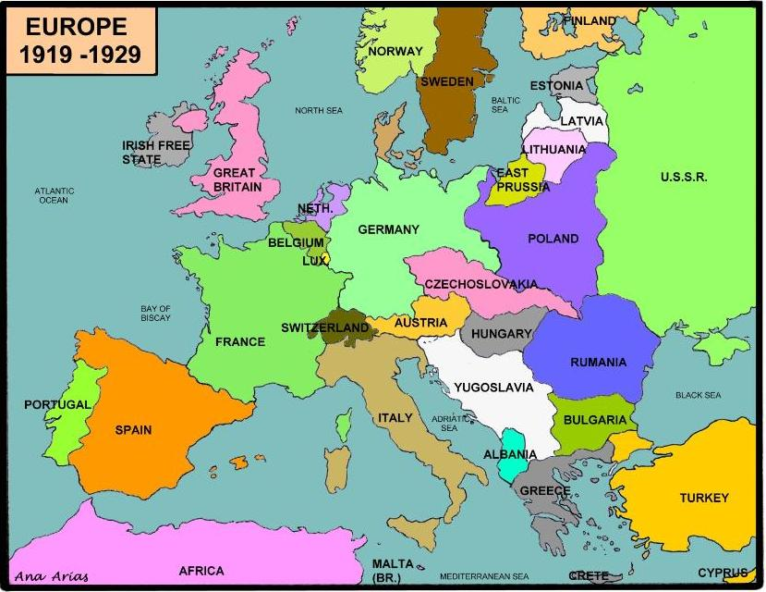
This Photo by Unknown Author is licensed under CC BY-SA-NC

Slide 25

World war 1
By Josh Elworthy

