Slide 1
World War 1
by David Rossiter

Slide 2
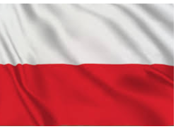
Hello my name is David and I will be doing the History of Poland during World War I

Slide 3
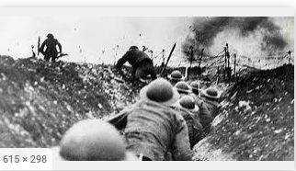
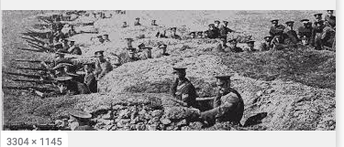
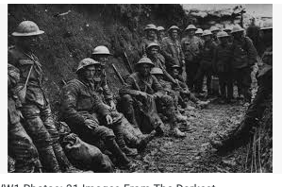
World War 1
28th July 1914 - 11 November 1918 28th July 1914 - 11 November 1918
World War I began in 1914 after the assassination of Archduke Franz Ferdinand and lasted until 1918. During the conflict, Germany, Austria-Hungary, Bulgaria and the Ottoman Empire (the Central Powers) fought against Great Britain, France, Russia, Italy, Romania, Japan and the United States (the Allied Powers).
Thanks to new military technologies and the horrors of trench warfare, World War I saw unprecedented levels of carnage and destruction. By the time the war was over and the Allied Powers claimed victory, more than 16 million people—soldiers and civilians alike—were dead.

Slide 4
When World War I started, Polish territory was split during the partitions between Austria Hungary, the German Empire and the Russian Empire, and became the scene of many operations of the Eastern Front of World War One.
A total of 2 million Polish troops fought in World War One
In the aftermath of the war, following the collapse of the Russian, German and Austro-Hungarian Empires, Poland became an independent republic

Slide 5
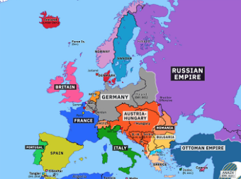
Poland in the years leading up to & during World War I, did not exist. Today's Poland, was then divided between the countries of Germany, Russia & Austria. Each of these countries had Poles in their armies.
Poles served in both the Allied & Central Powers armies, forcing Poles to sometimes fight against each other on both the Eastern & Western Fronts.

Slide 6
450,000 people in Poland died
Close to one million polish troops were wounded
Several hundred thousand Polish civilians were moved to labor camps in Germany, and 800,000 were deported by the Tsarist forces to the East

Slide 7
Starting in 1915 & 1916 respectively, Canadian & Australian Poles were showing up in the European war on the Western Front, along side of the other British and French armies
Most of the Poles in the Russian army, were involved in the Eastern Front, opposing the Central Powers armies, including other Poles in the German (Prussian) and Austrian-Hungarian armies
By the end of 1917, the largest number of ethnic poles on the Allies Western Front, came likely, from American forces. It is estimated that over 300,000 Polish-Americans served in World War I and 12 percent of the U.S. casualties were ethnic Poles

Slide 8
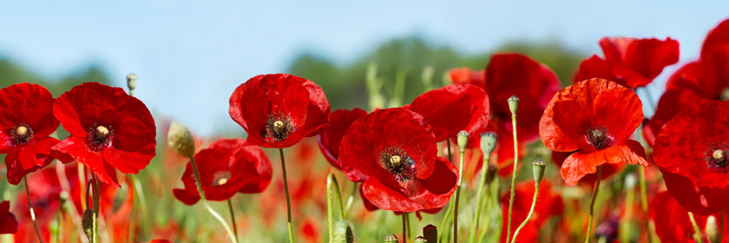
In 1916, attempting to increase Polish support for the Central Powers and to raise a Polish army, the German and Austrian emperors declared that a new state called the Kingdom of Poland would be created
Early in 1917 U.S. President, Woodrow Wilson expressed his support for an independent and autonomous Poland. His statement likely had a positive effect on unifying the Polish-American war effort.

Slide 9
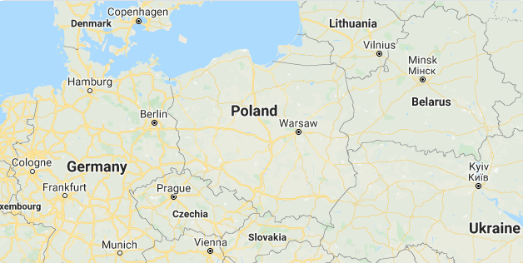
11 November 1918
On 11 November 1918, after 123 years, Poland regained its independence from the German, Austro-Hungarian and Russian Empires.

Slide 10
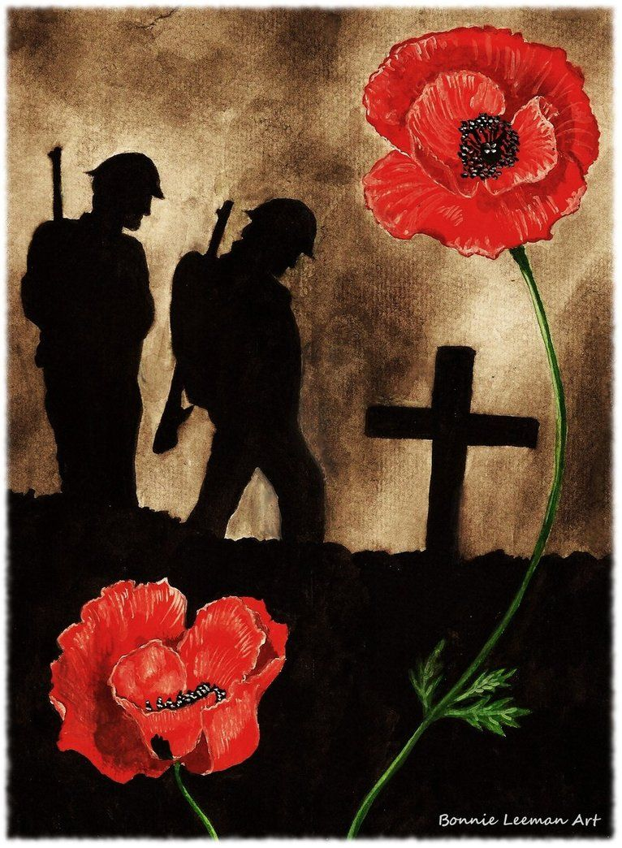
World War One ended at 11am on 11 November, 1918.
This became known as Armistice Day - the day Germany signed an armistice (an agreement for peace) which caused the fighting to stop. People in Britain, France and the countries that supported them celebrated.

