Slide 1
World War I specifically 1914
By Fionn Vennard

Slide 2
How WWI Started
WWI started when Austrian archduke Franz Ferdinand was killed by South Slav nationalist Gavrilo Princip on June 28th 1914.

Slide 3
Which Country Started WWI
Germany and Austria-Hungary started WWI

Slide 4
Which Countries were in The War in 1914
The war initially started between the german/Austria-hungary alliance and serbia
The Triple Entente of Britain, France and Russia joined Serbia in the war in 1914.
While Italy had been an ally of Germany and Austria hungary, they joined the british in the war in 1914.
later on Japan Joined the British in the war.

Slide 5
What was the biggest battle in 1914
The biggest battle in 1914 was The Battle of the Somme with over 420,000 casualties suffered by the British and 500,000 casualties suffered by the Germans.

Slide 6
Who were the main leaders of Wwi in 1914
The main leaders of WWI in 1914 were: David Lloyd George for Britain, Kaiser Wilhelm Ii for germany,
Tsar Nicholas II for Russia , Vladimir Lenin for Russia.

Slide 7
How much people died in Wwi
8 million people died in WWI and 21 million people were injured.

Slide 8
Facts
An explosion on the battle field in France was heard in England.
WWI journalists risked their lives to report on the war.
Twelve million letters were delivered to the front line every week.

Slide 9
Facts
Plastic surgery was invented because of WWI.
The youngest British soldier in WWI was only twelve years old.

Slide 10
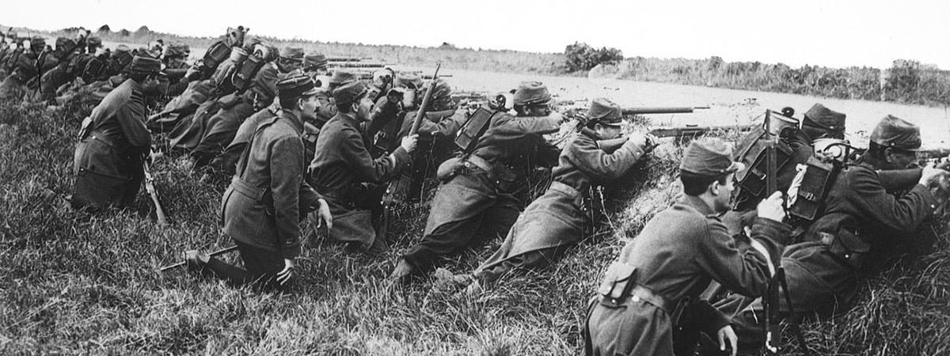
Pictures of WWI

Slide 11
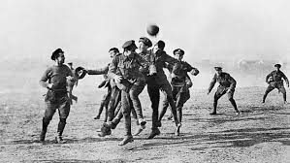
Pictures of WWI

Slide 12
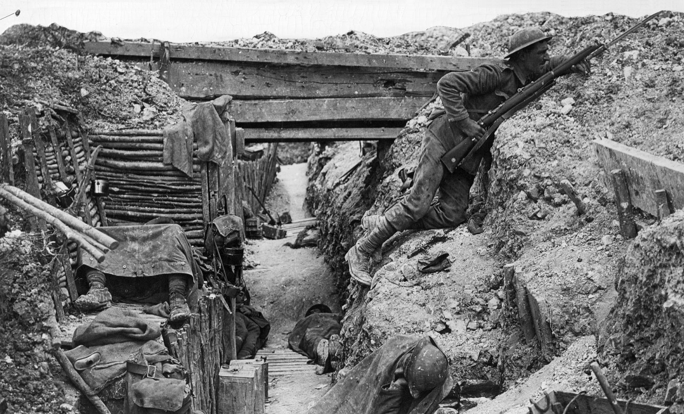
Pictures of WWI

